Slide 1
Lake Tahoe Retreat
by John Cagle

Slide 2
John Cagle’s notes on these photgraphs
These photographs were taken at the Pi Kappa Tau alumni retreat in Lake Tahoe in 1997.
At the retreat, Rick Turton and I resolved to launch a Pi Kappa Tau website, which we did, to-wit: http://www.pikappatau.com/
State of the art web design in the early days, due in part to the slow speed of downloads and the capabilities of computers, advised to limit filesize of photographs to 40 KB. I kid you not.
Recently I discovered my original negatives for these photos and make this 2019 PowerPoint. It is 86 MB.
1997 version in the archives below…. Enjoy the difference.

Slide 3
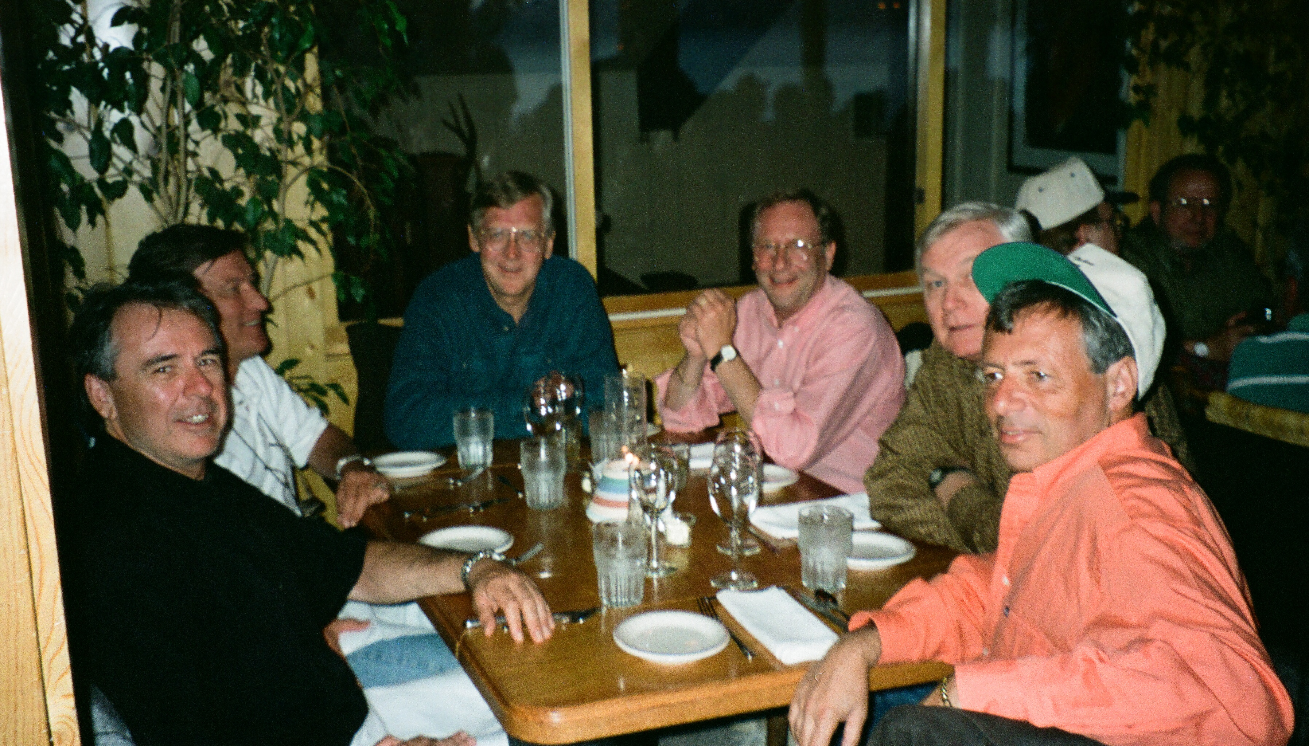

Slide 4
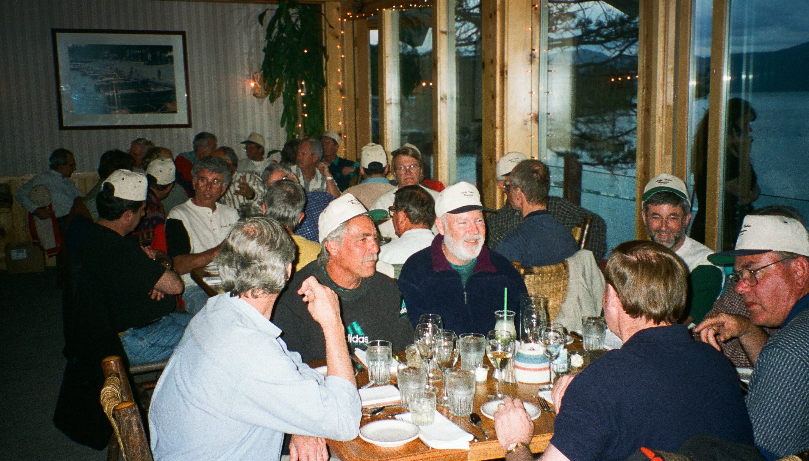

Slide 5
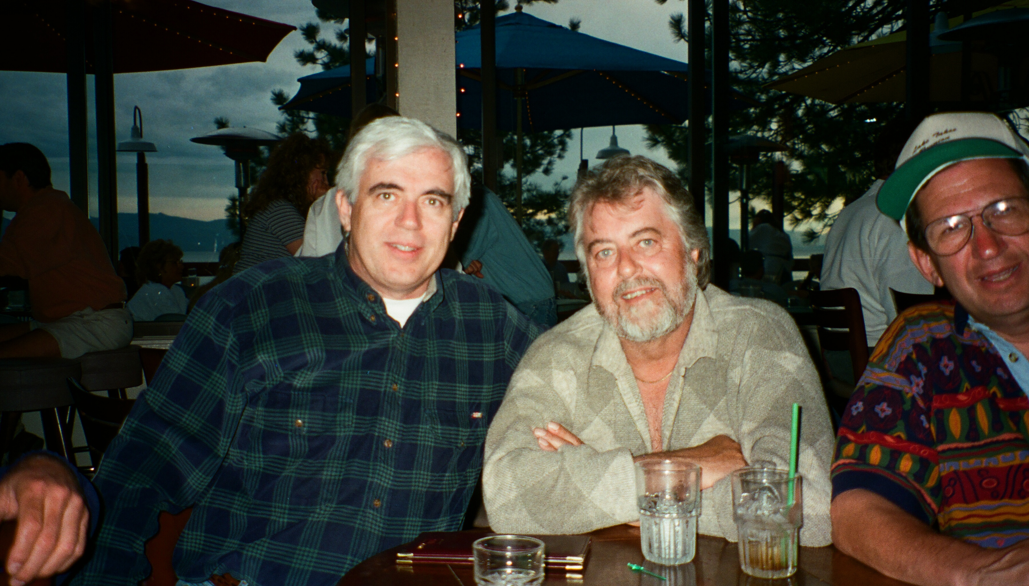

Slide 6
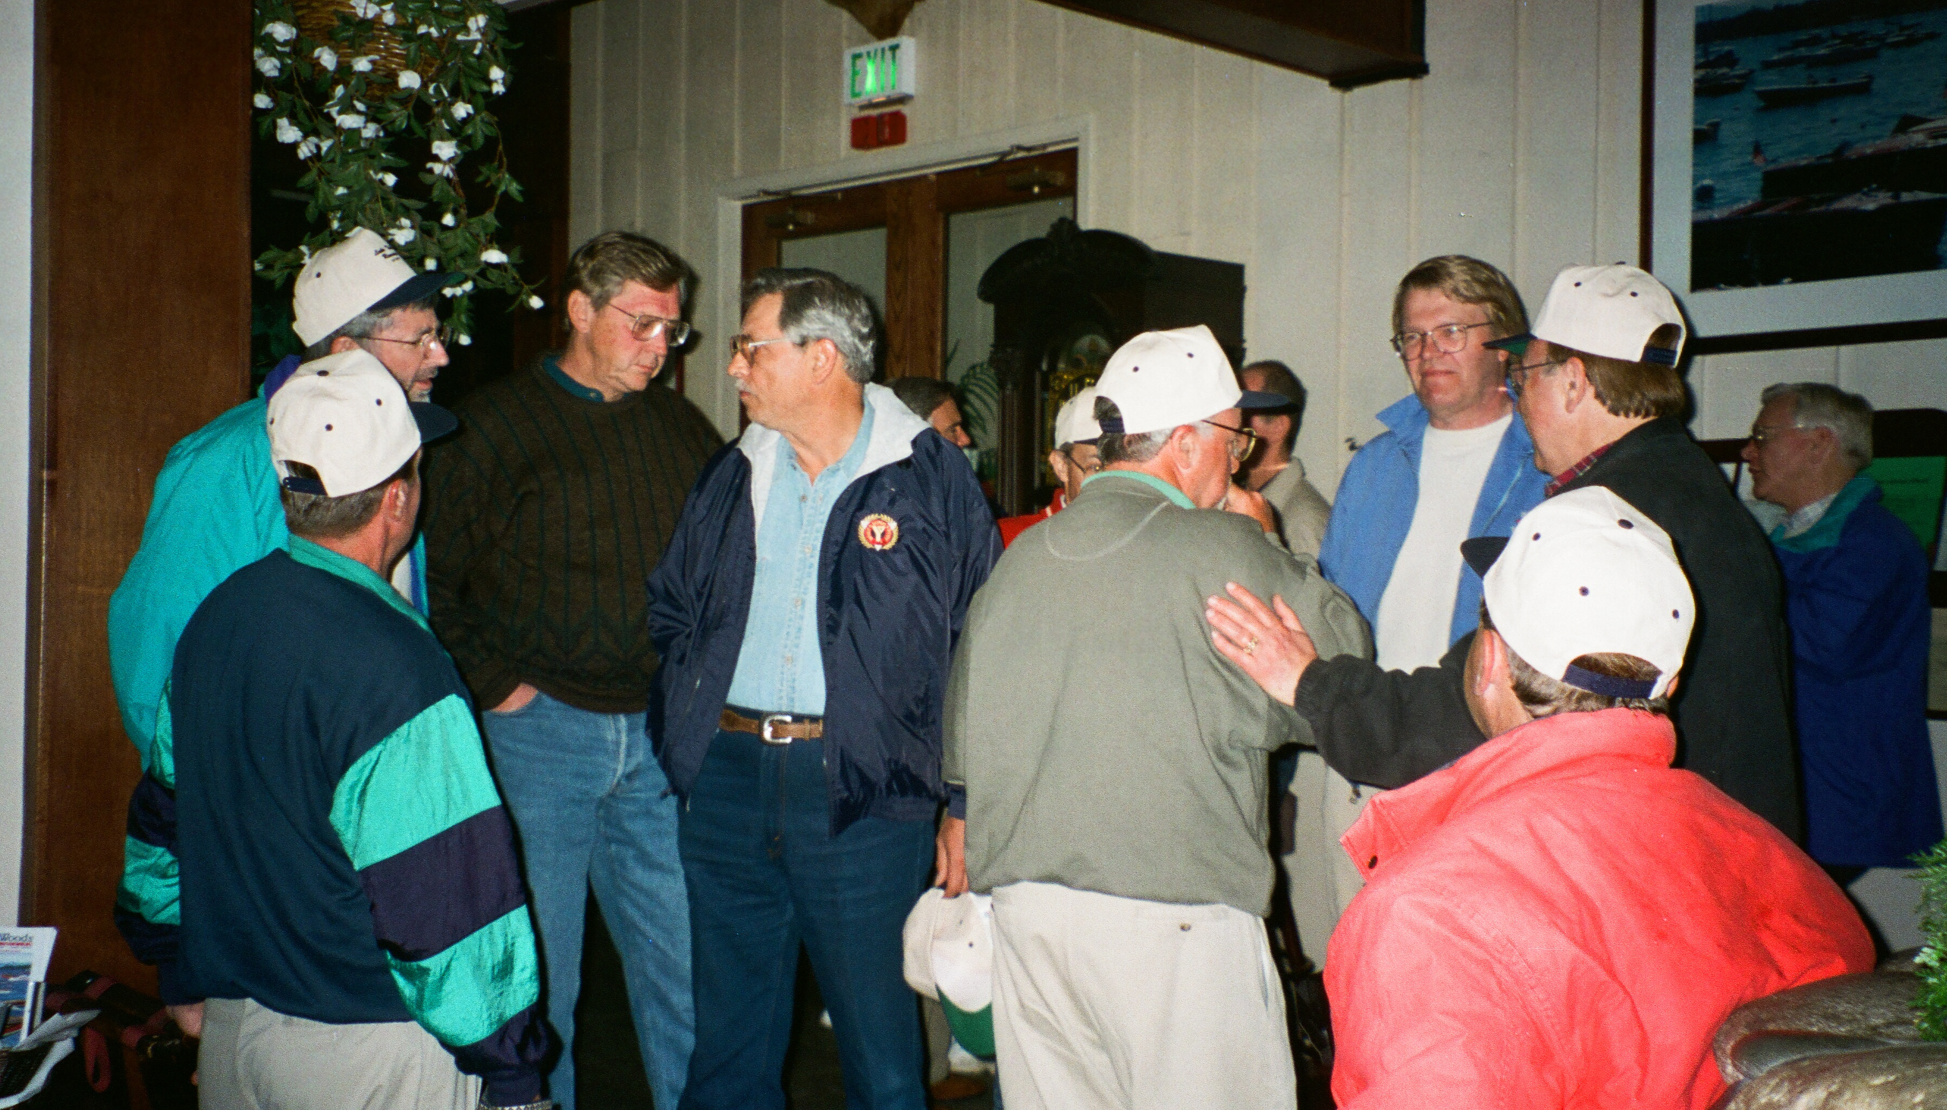

Slide 7
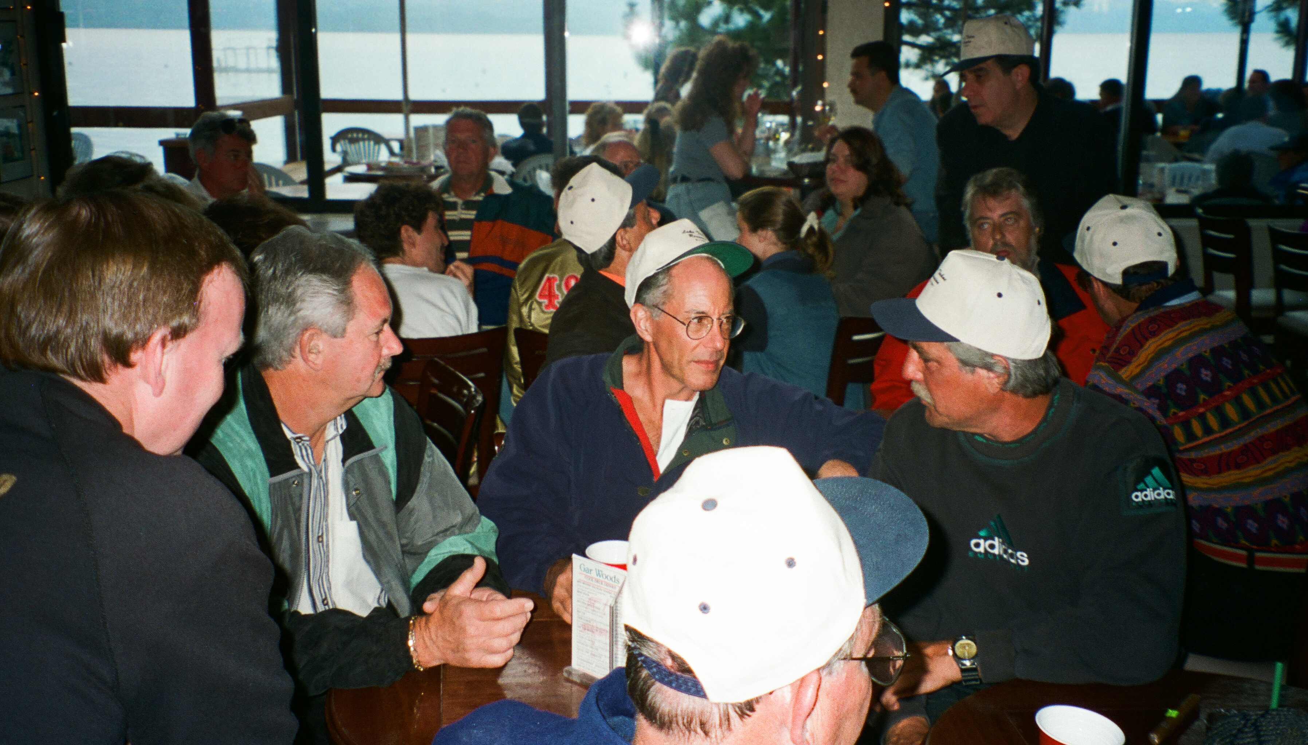

Slide 8
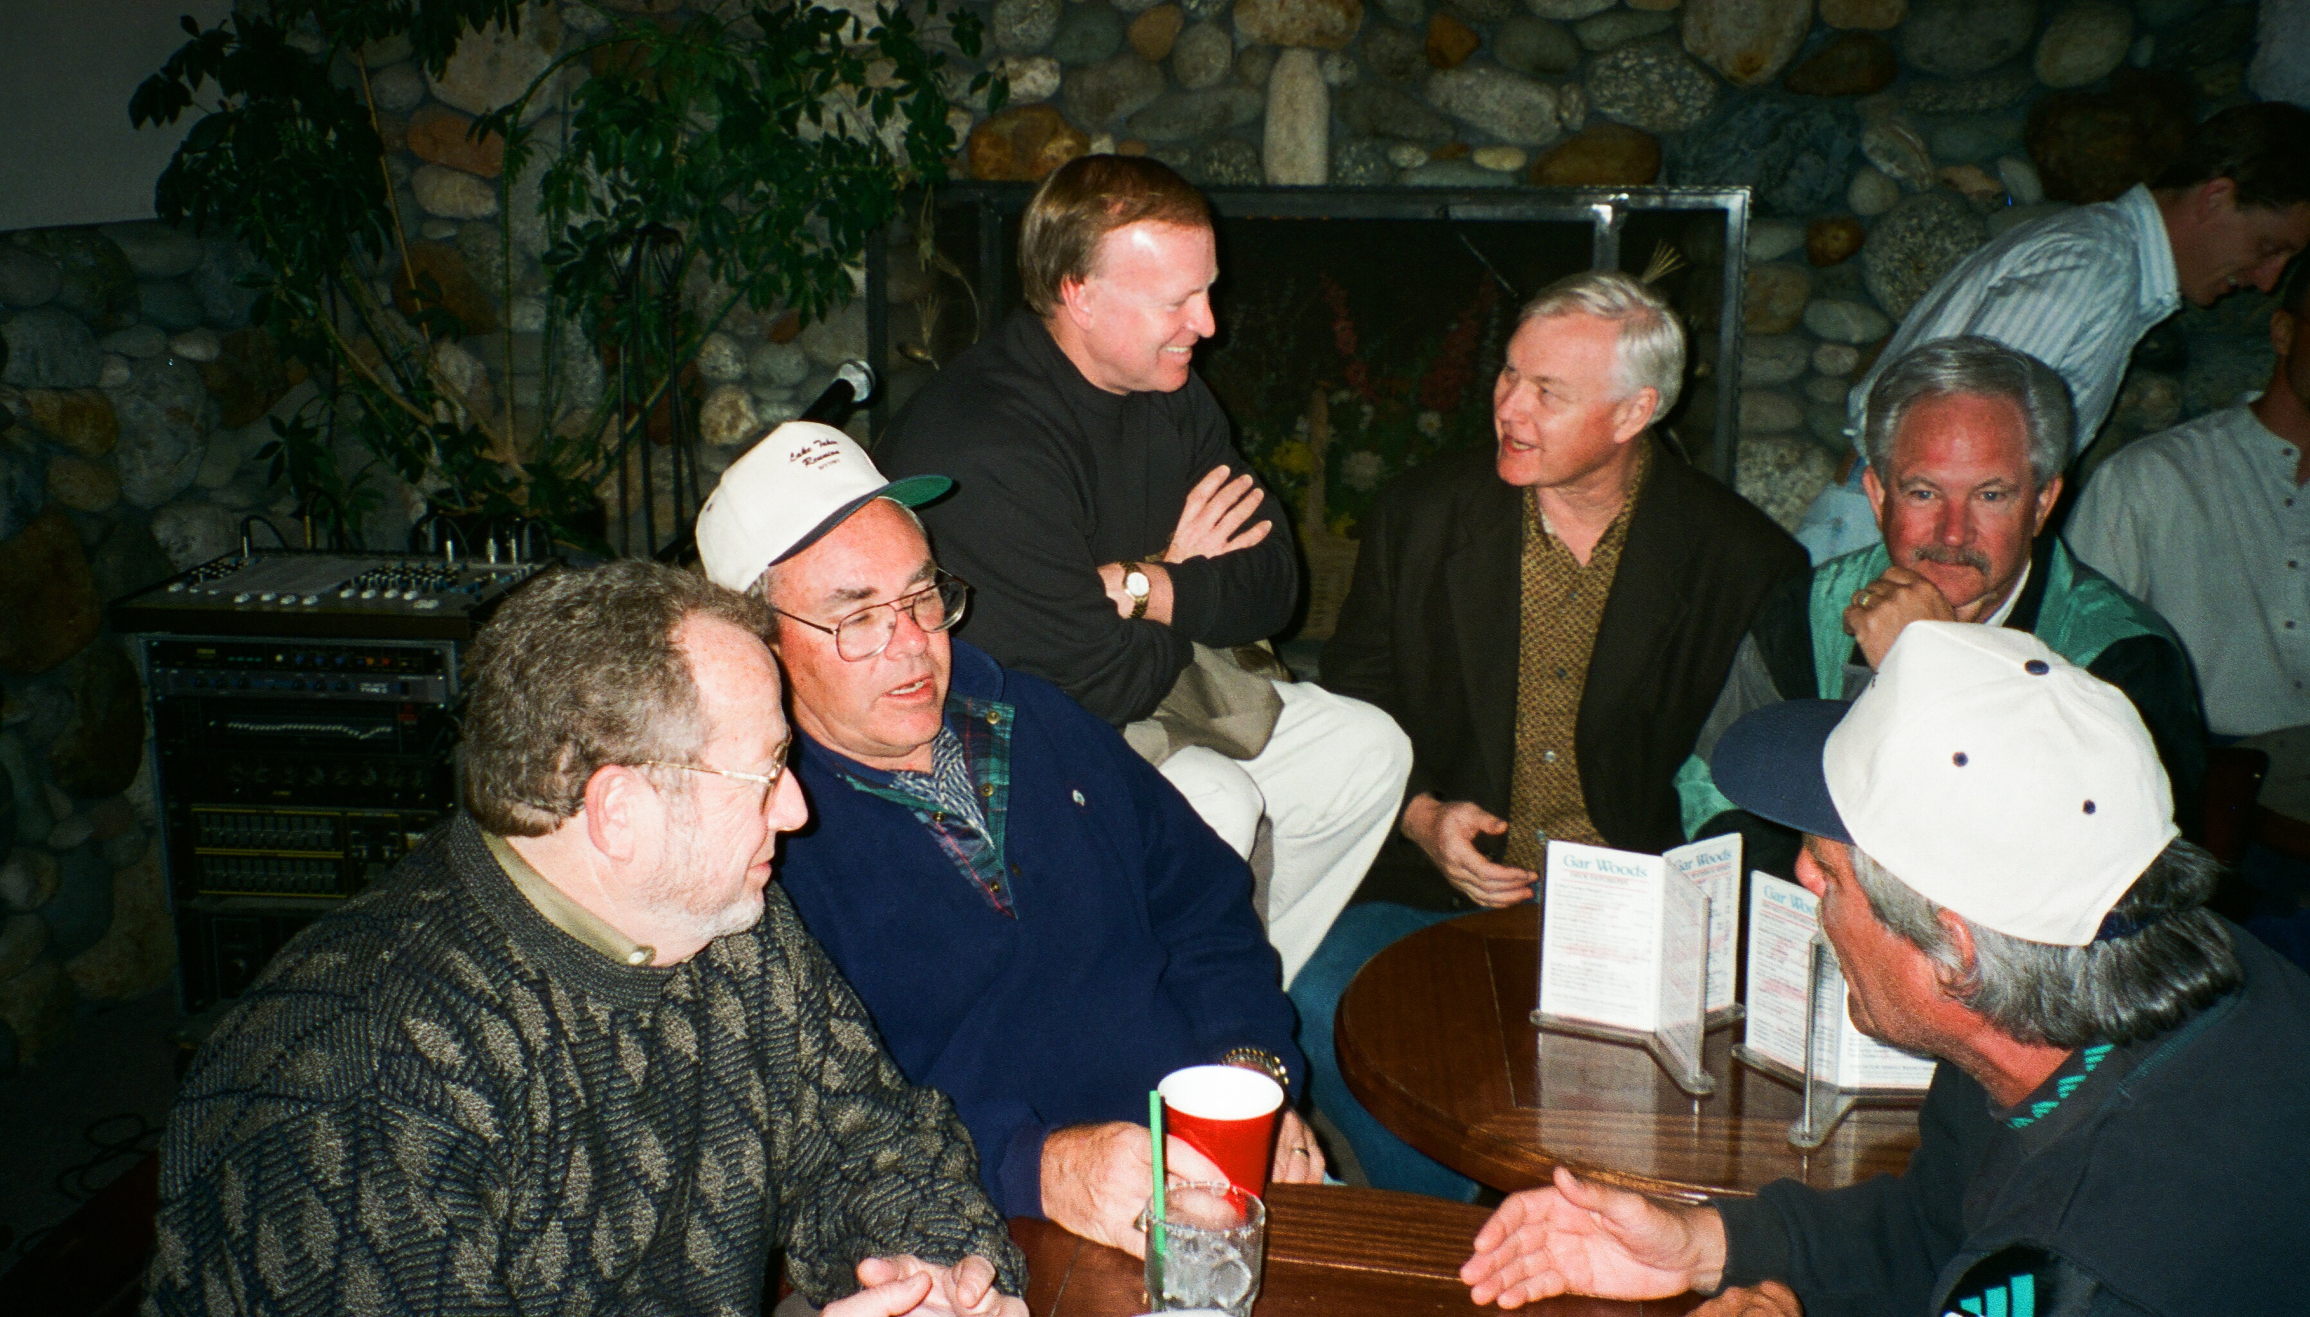

Slide 9
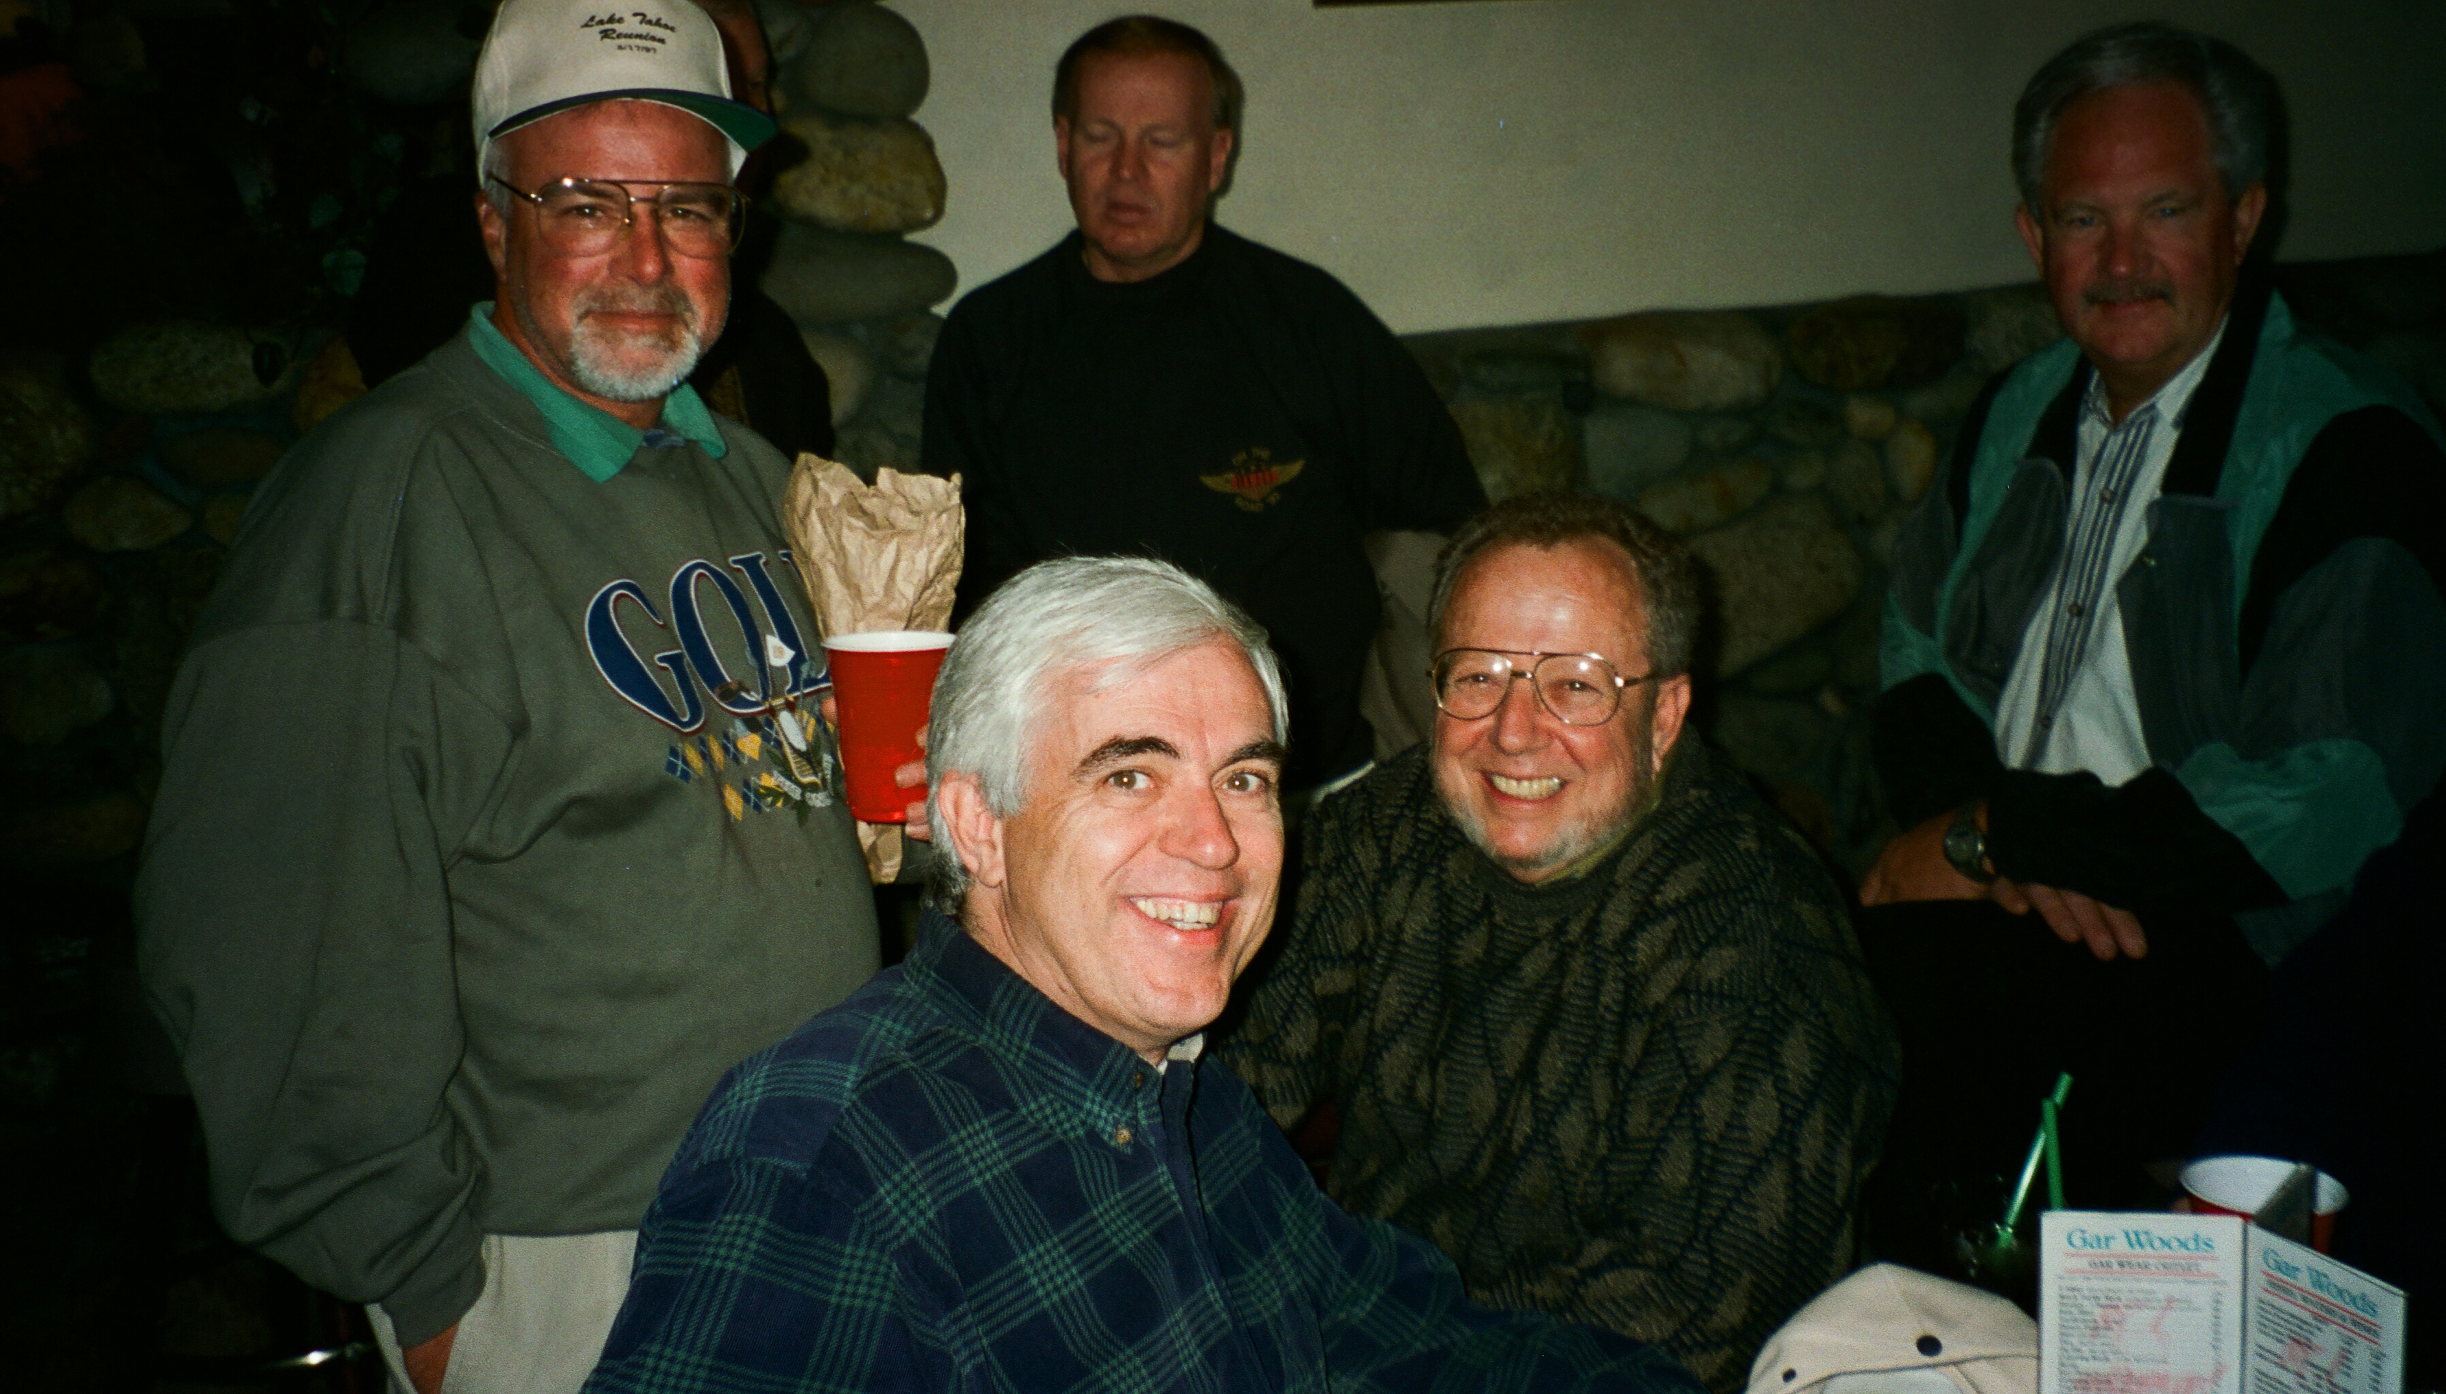

Slide 10
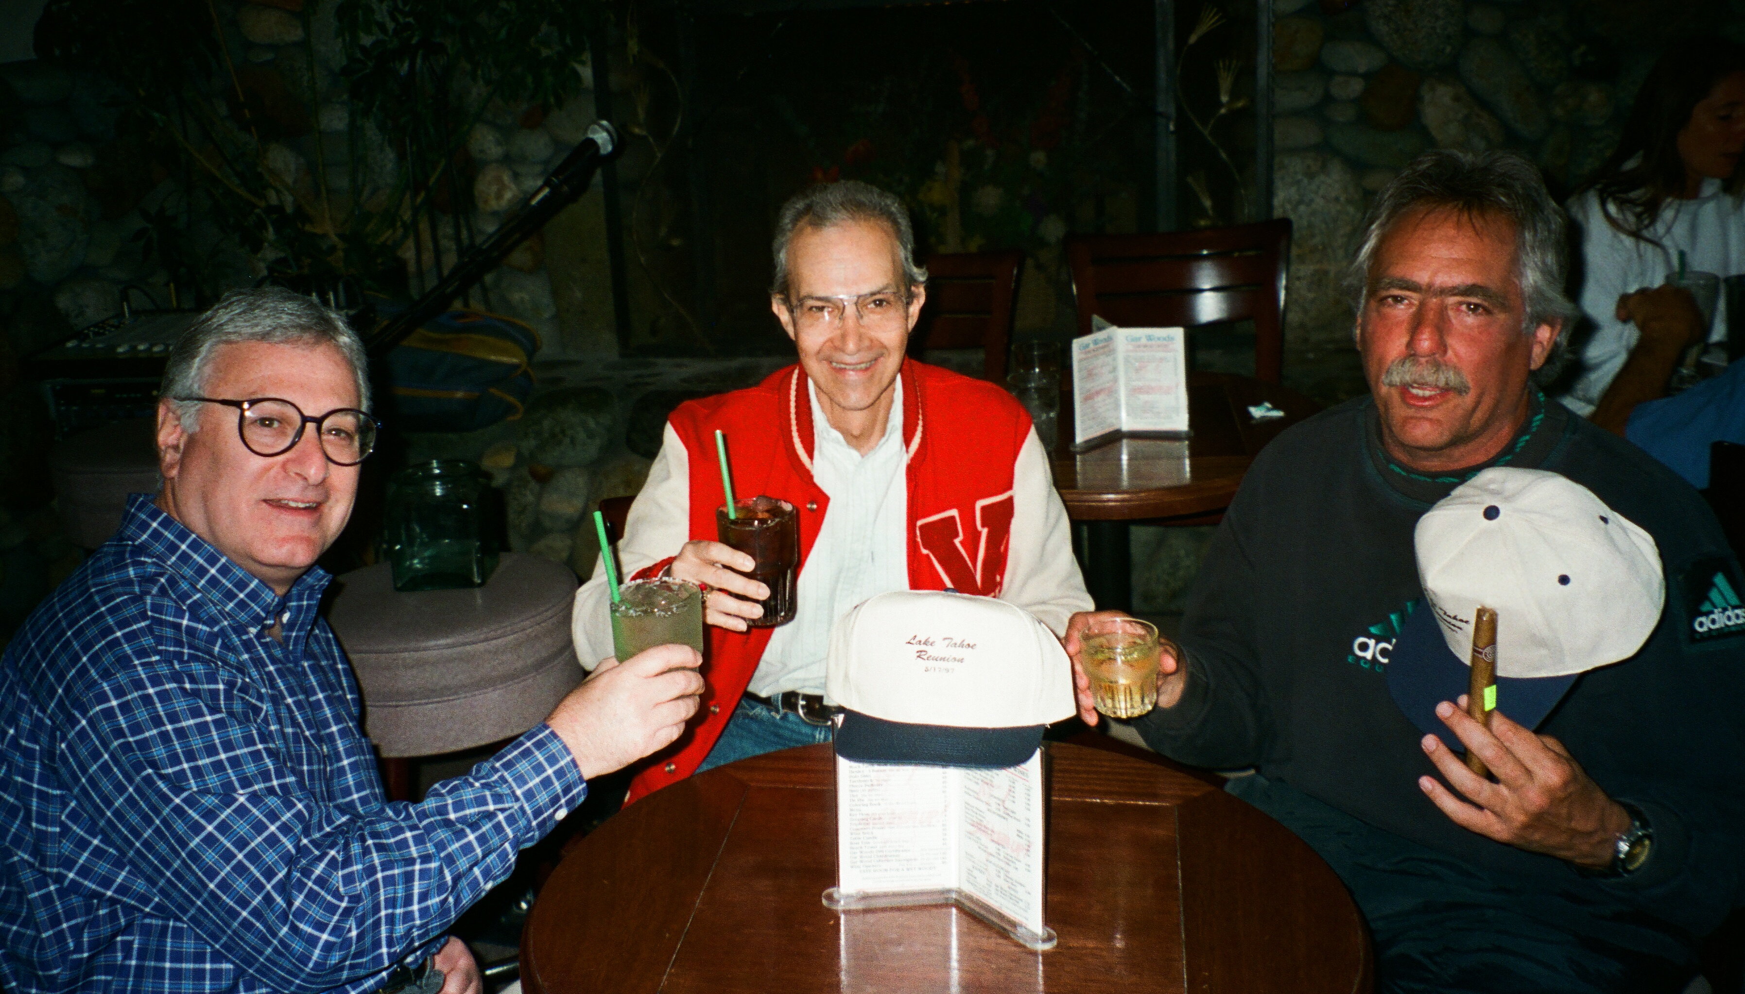

Slide 11
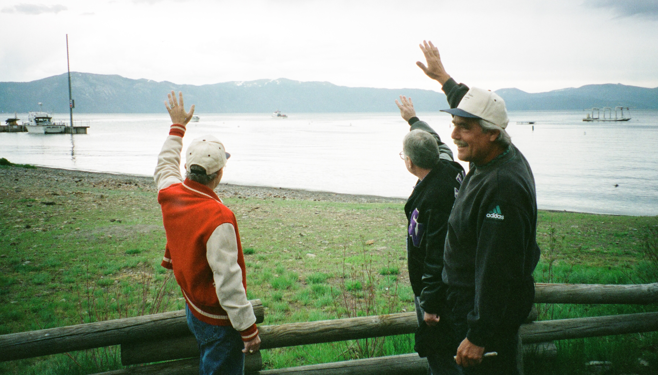

Slide 12
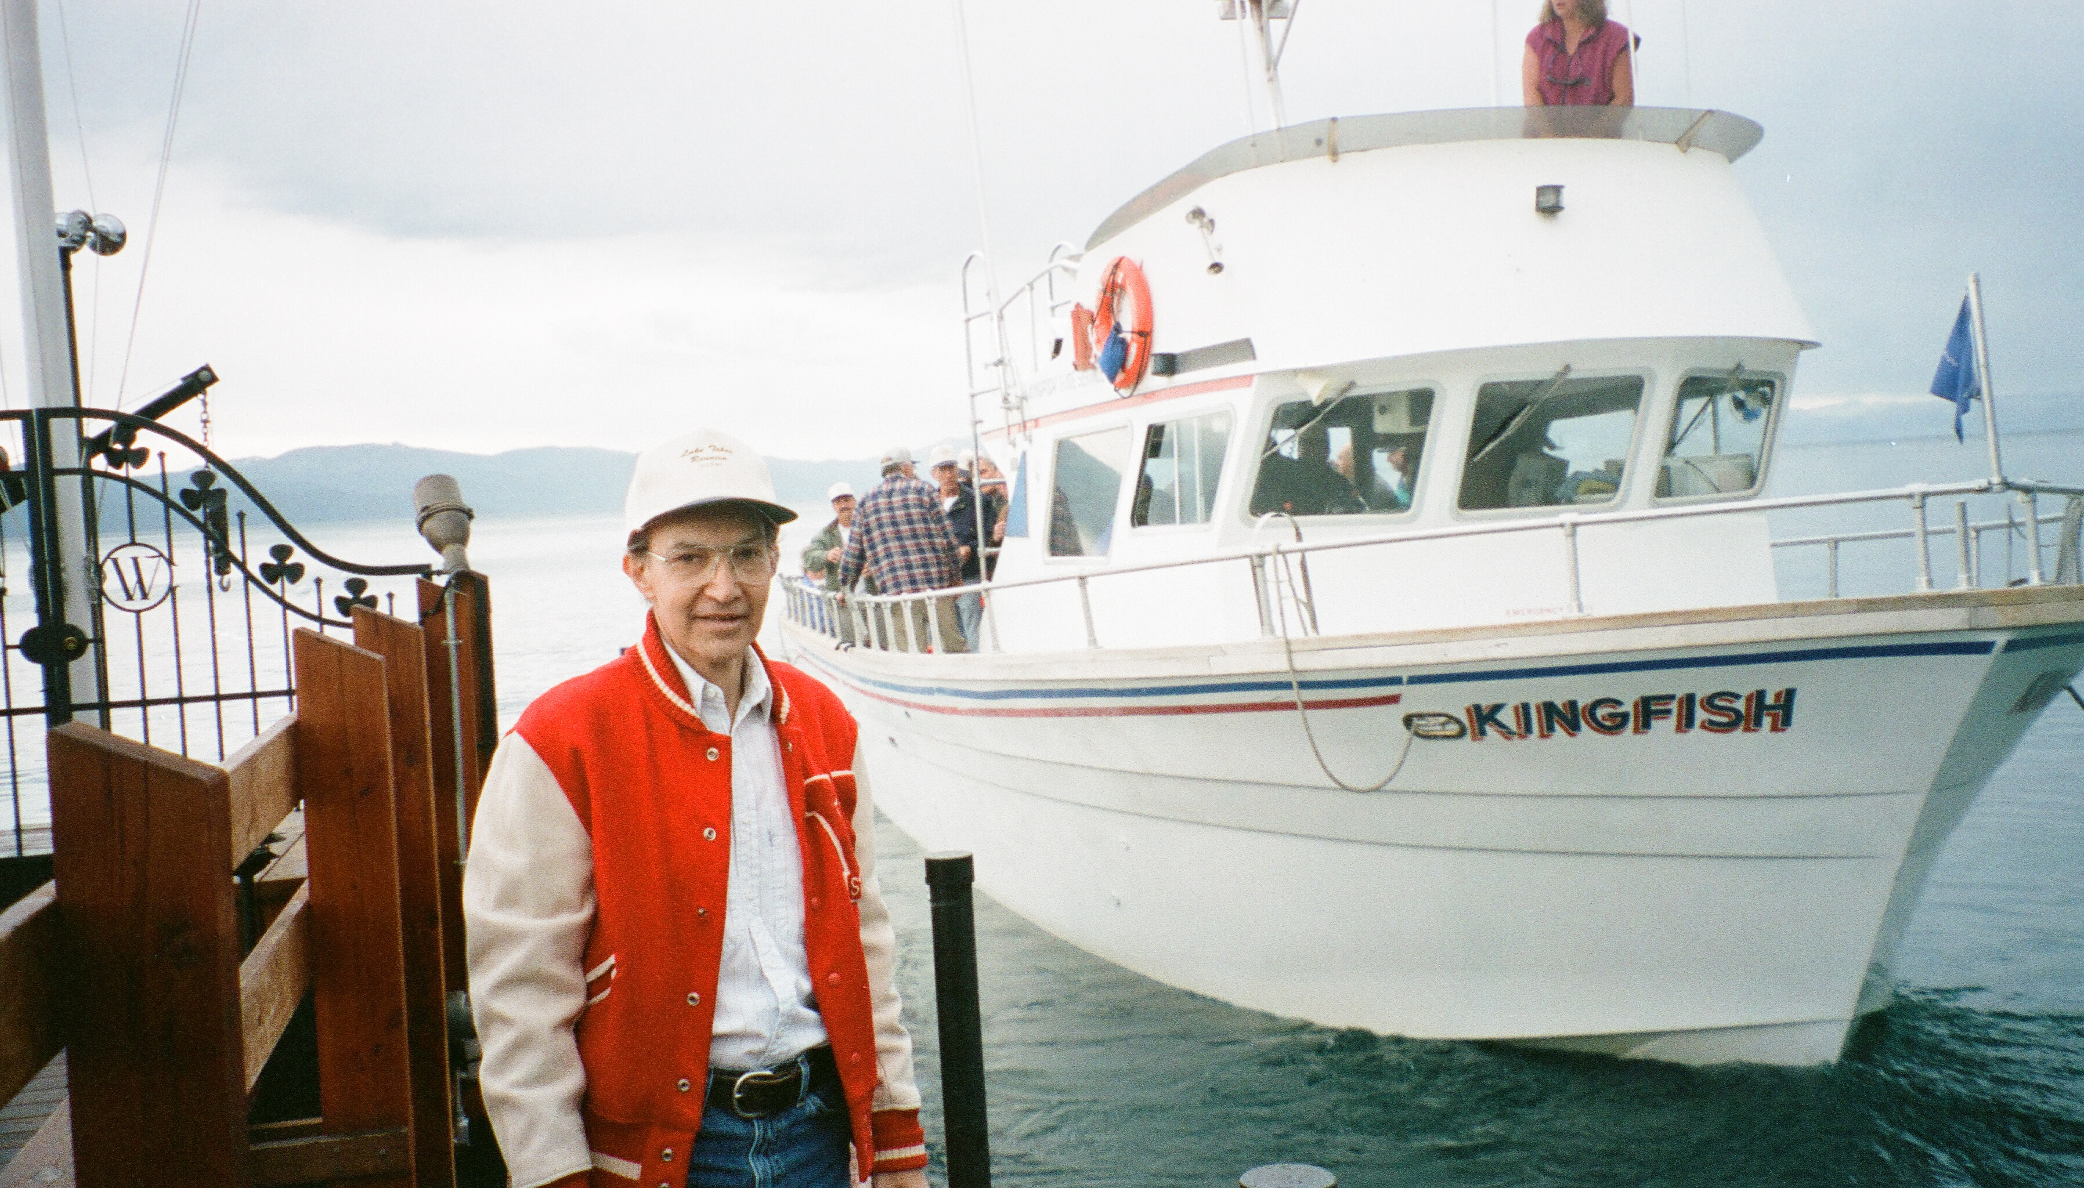

Slide 13
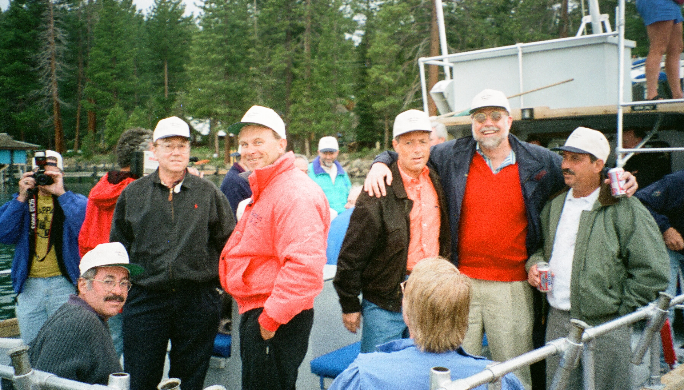

Slide 14
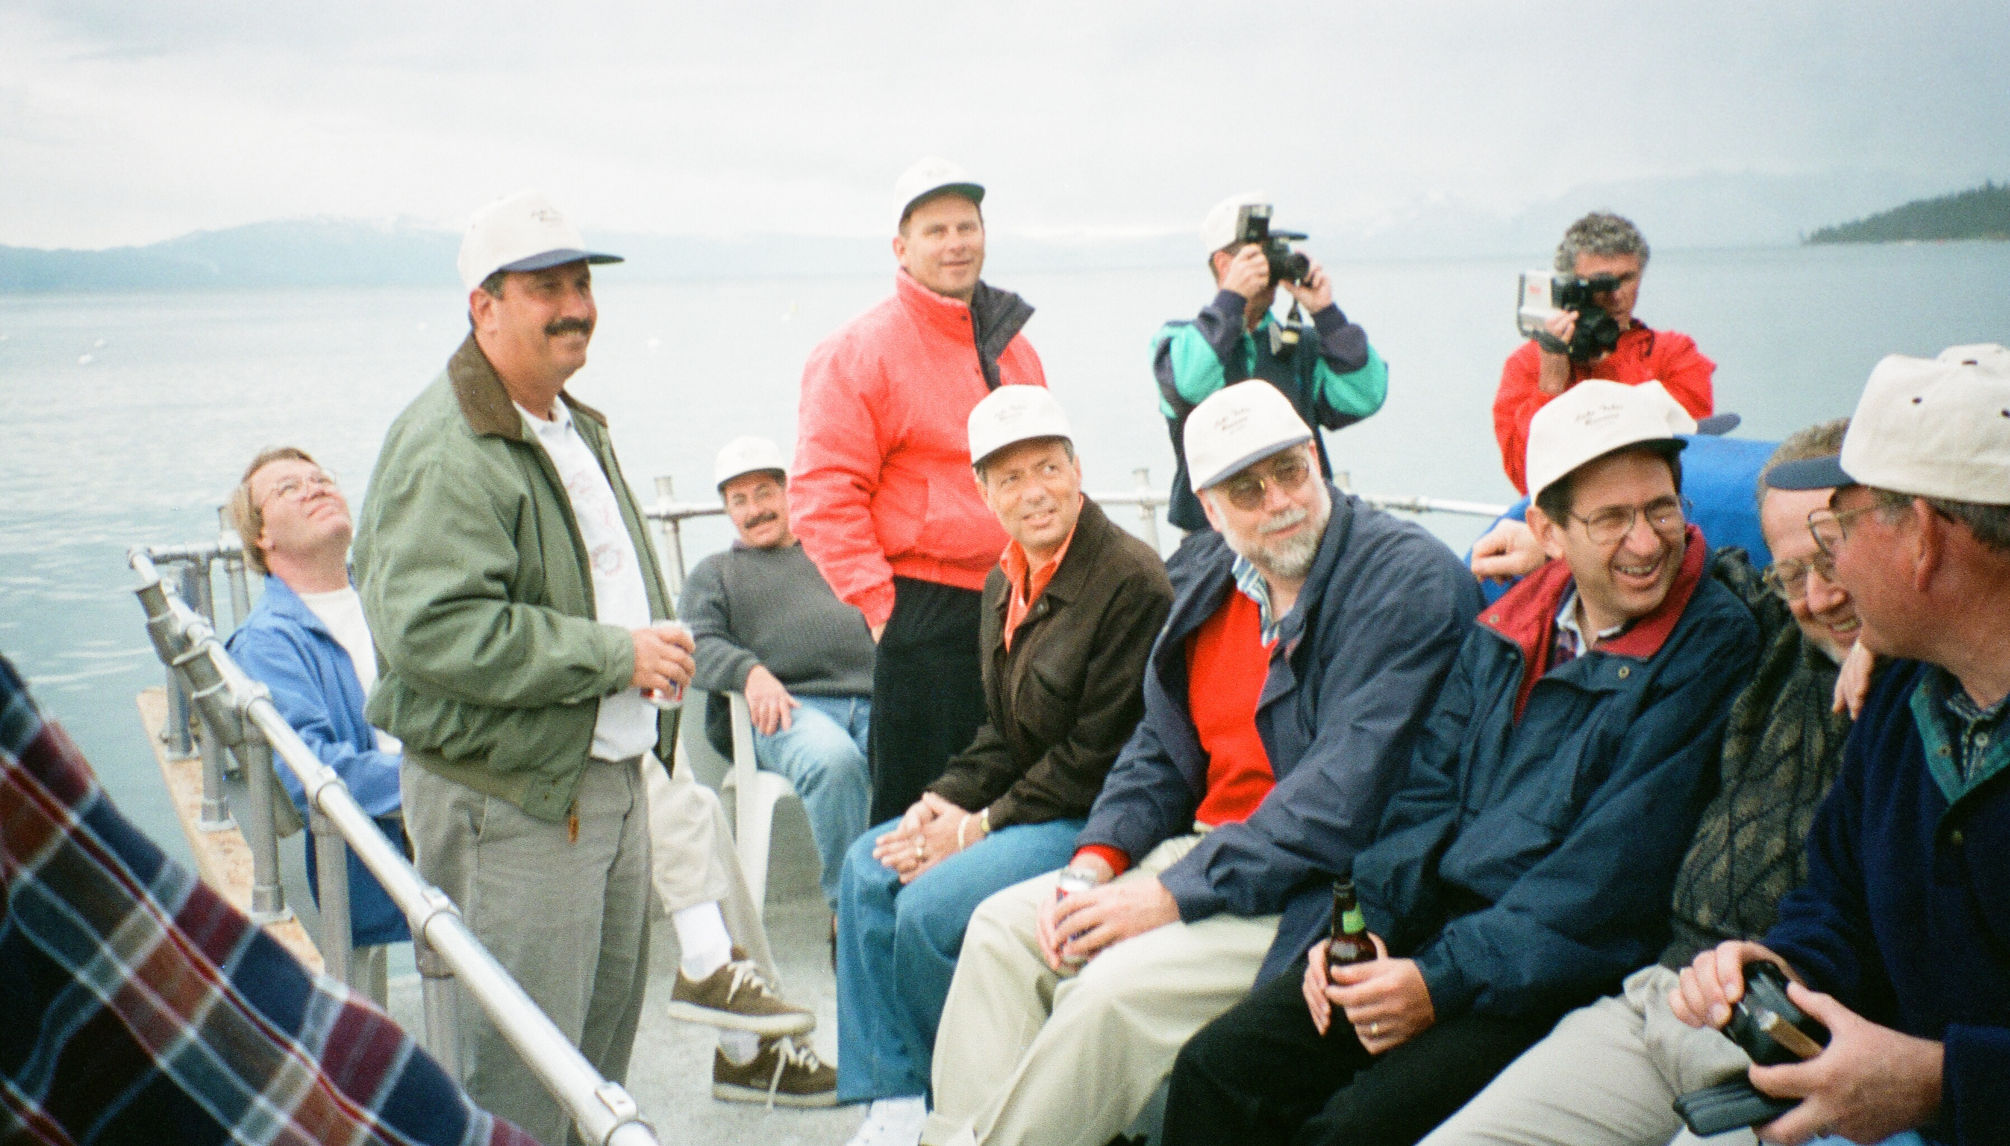

Slide 15
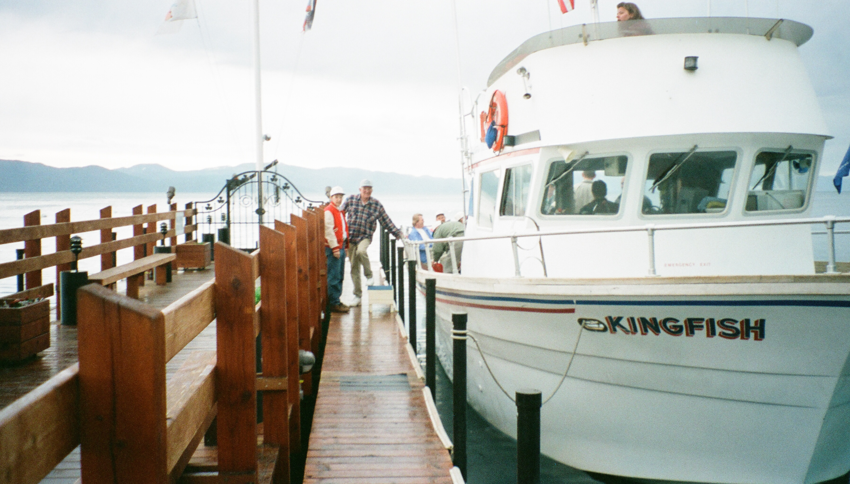

Slide 16
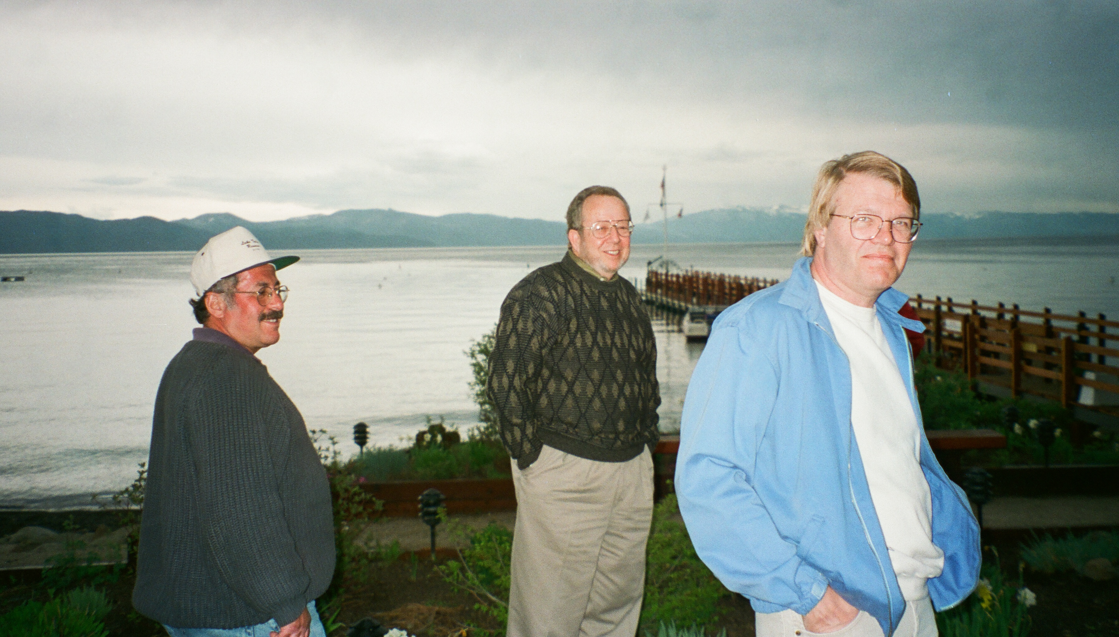

Slide 17
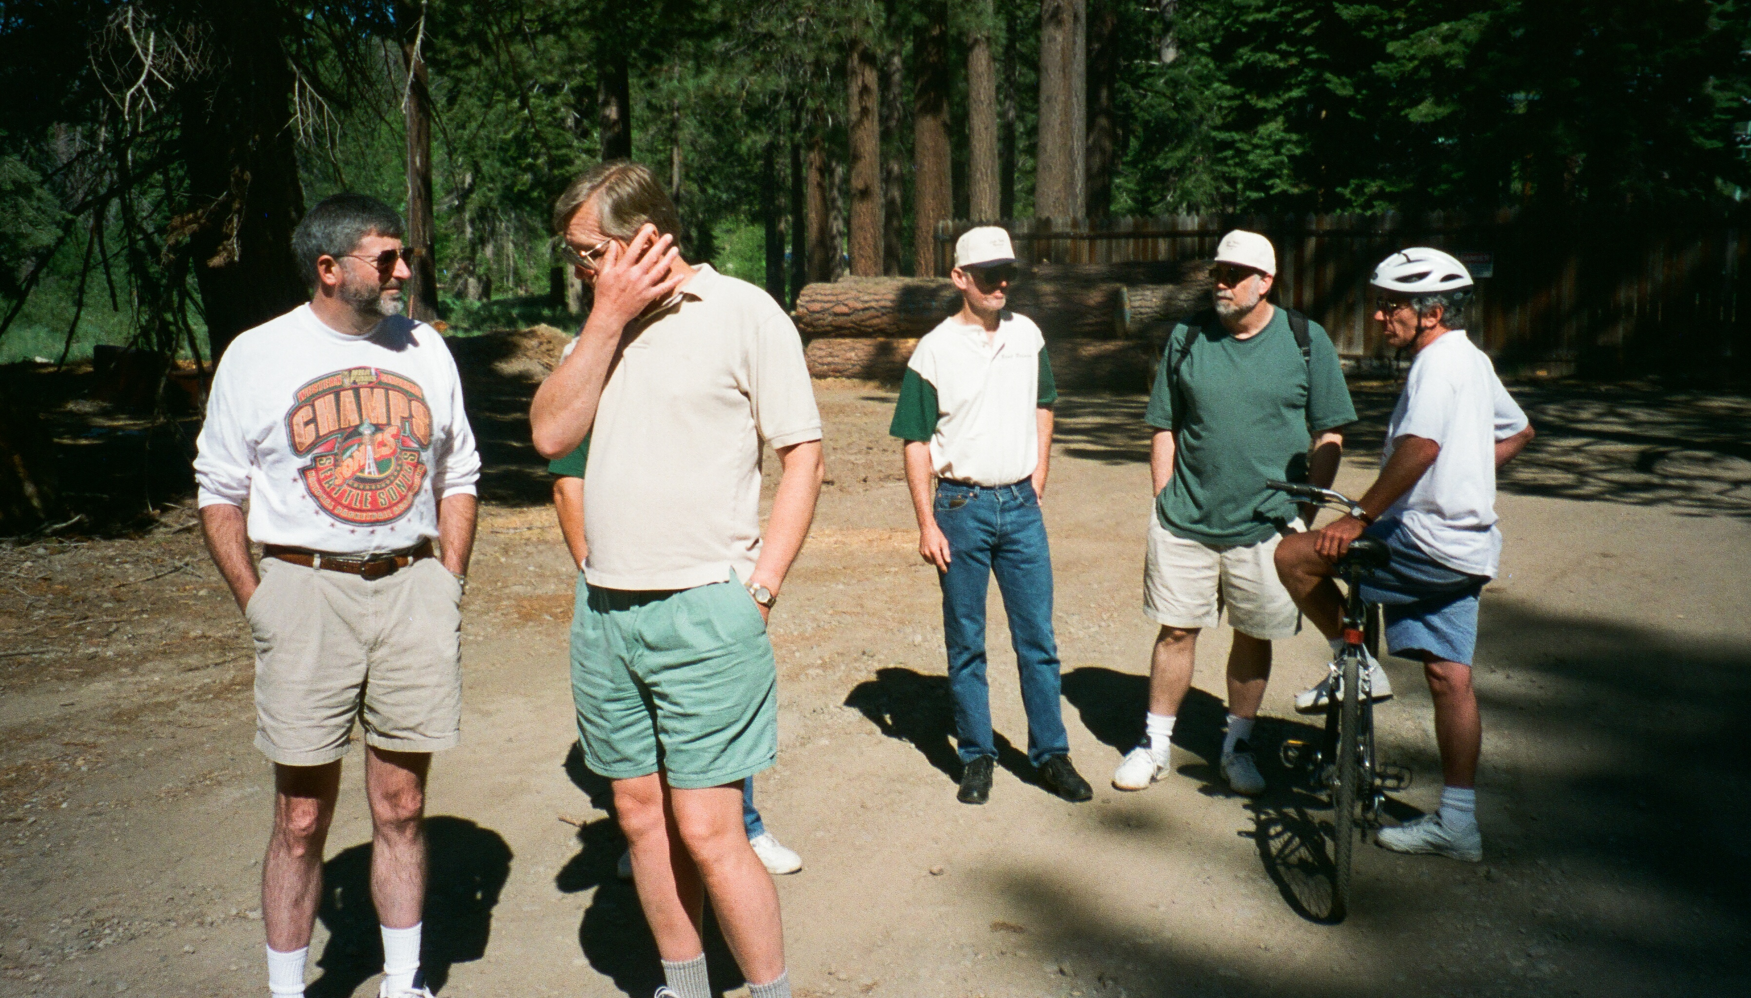

Slide 18
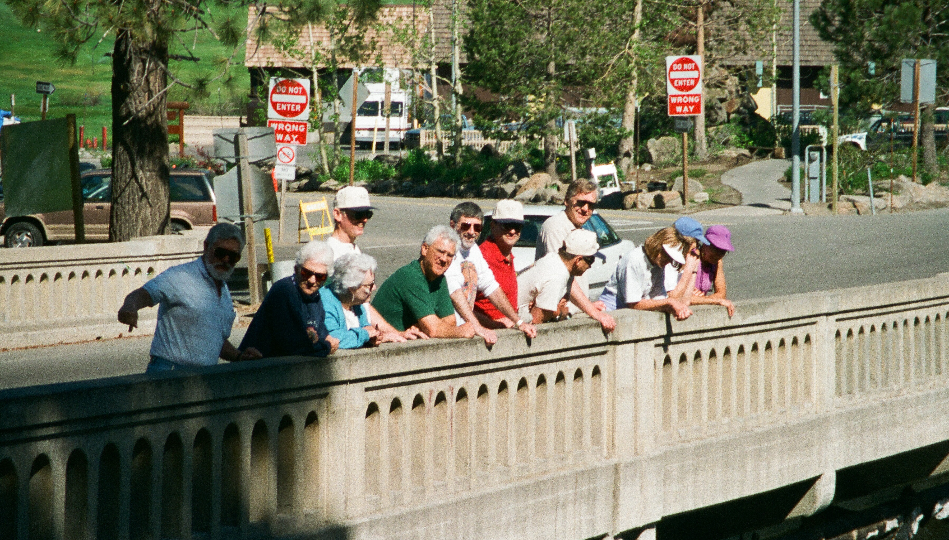

Slide 19
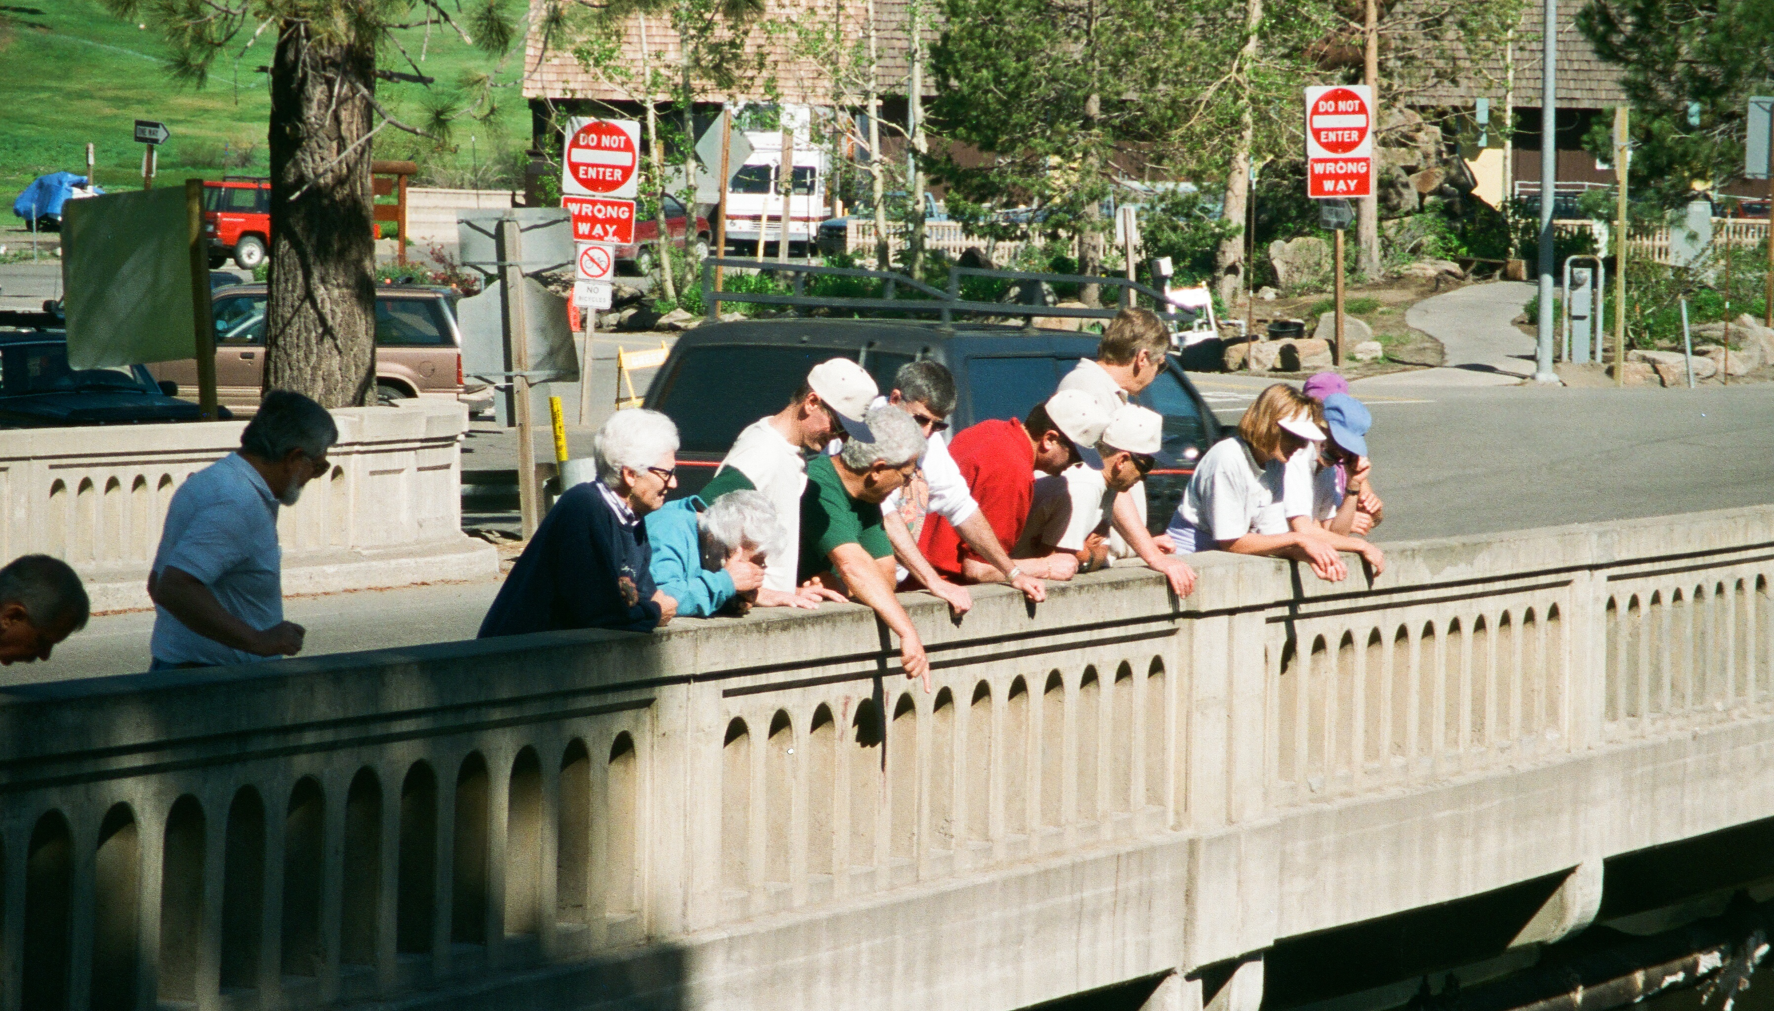

Slide 20
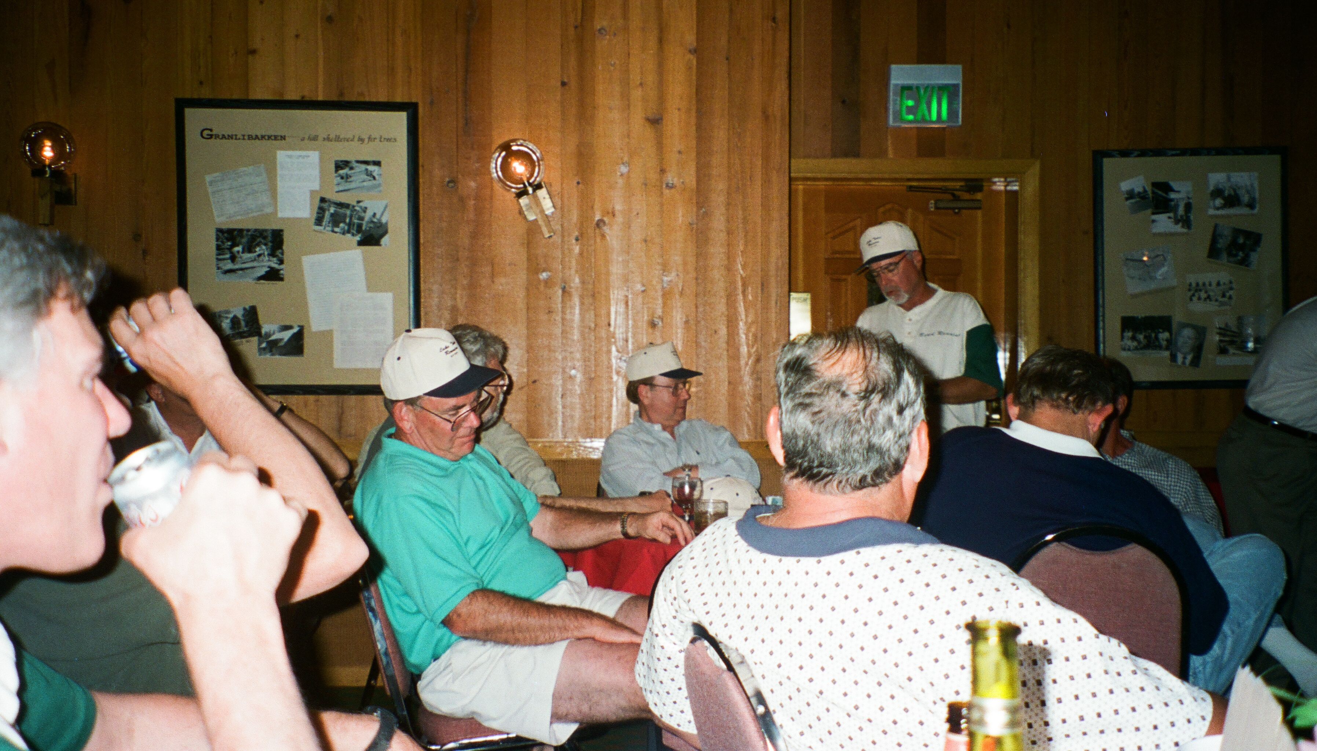

Slide 21
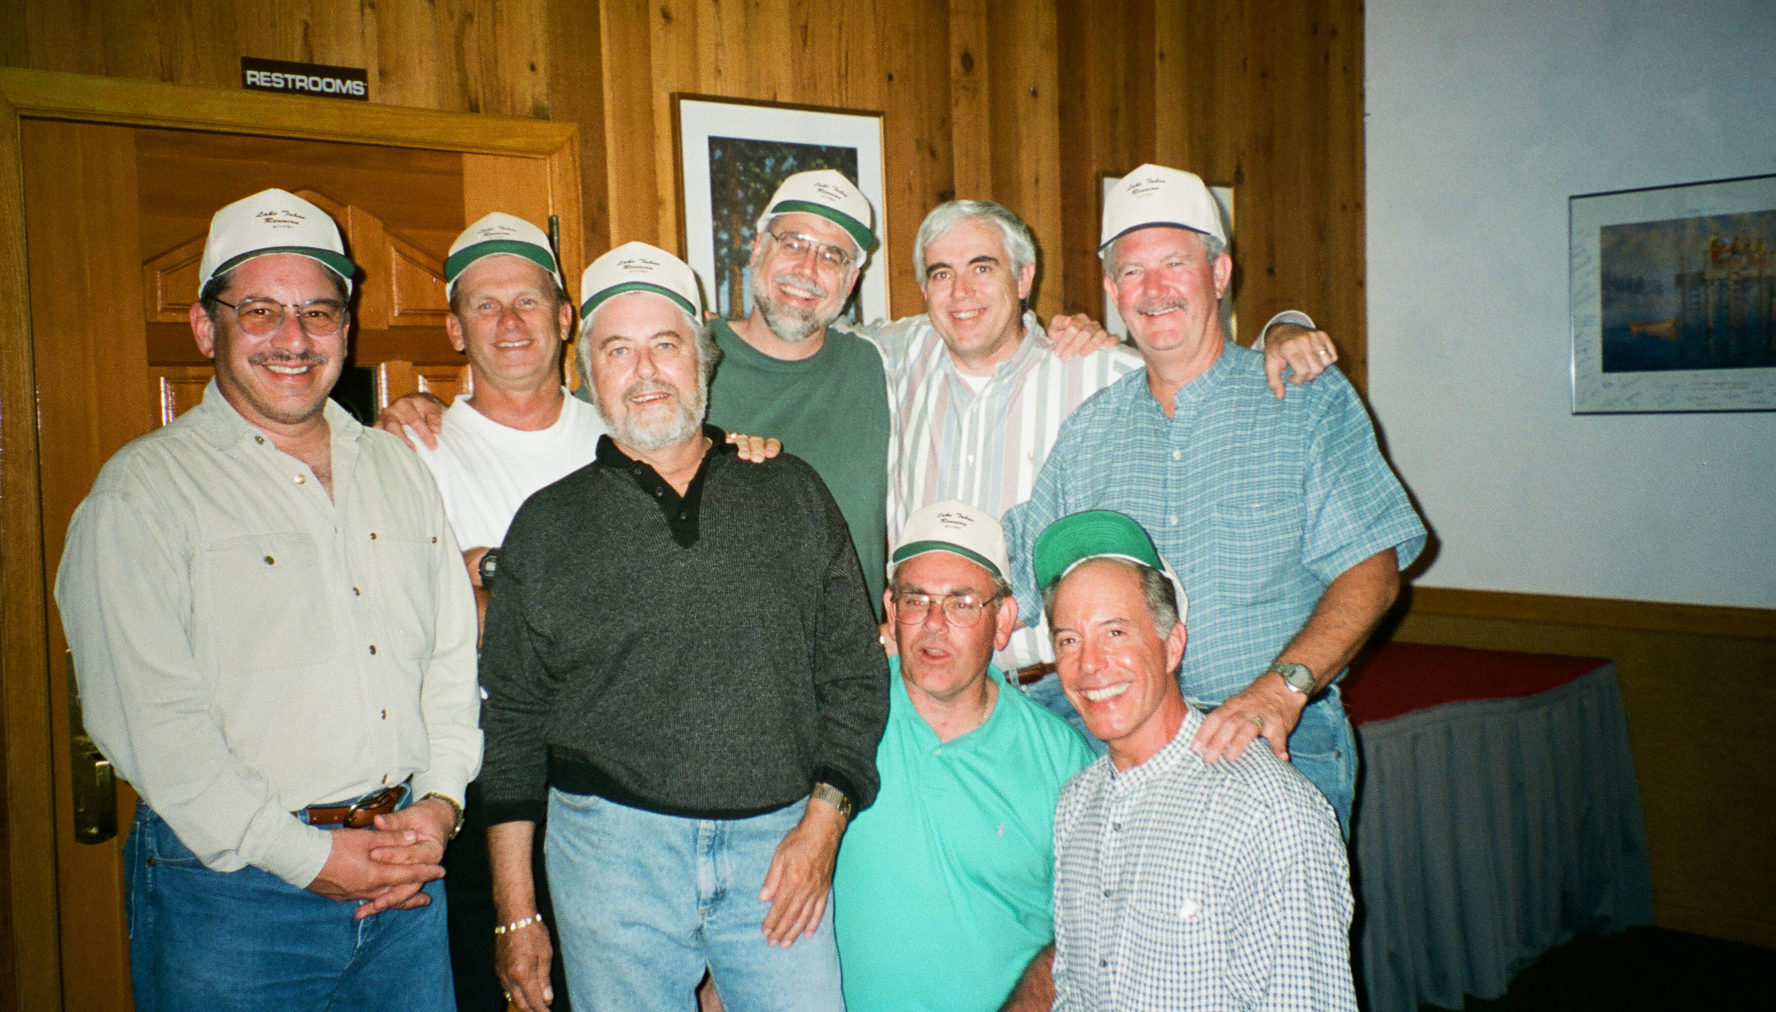

Slide 22
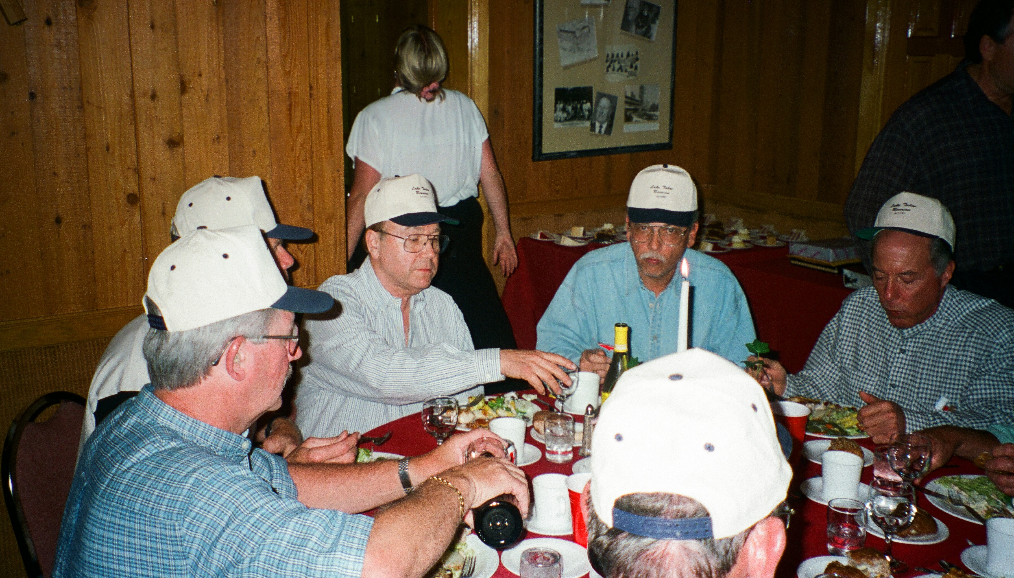

Slide 23
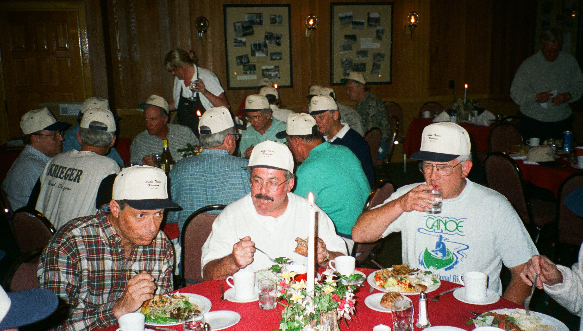

Slide 24
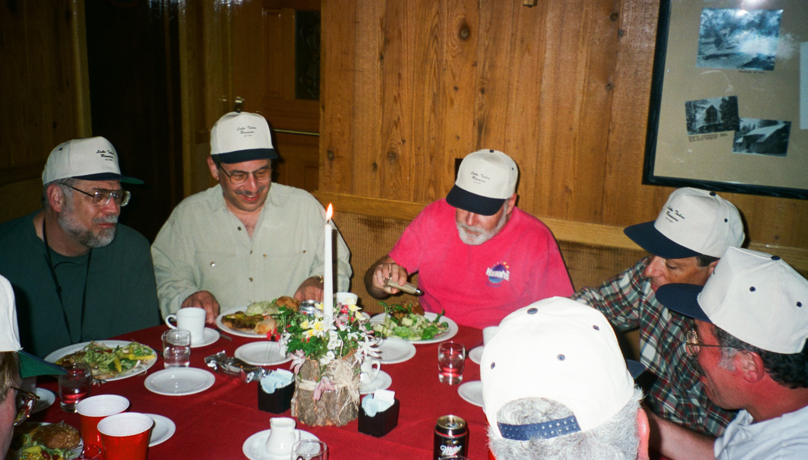

Slide 25
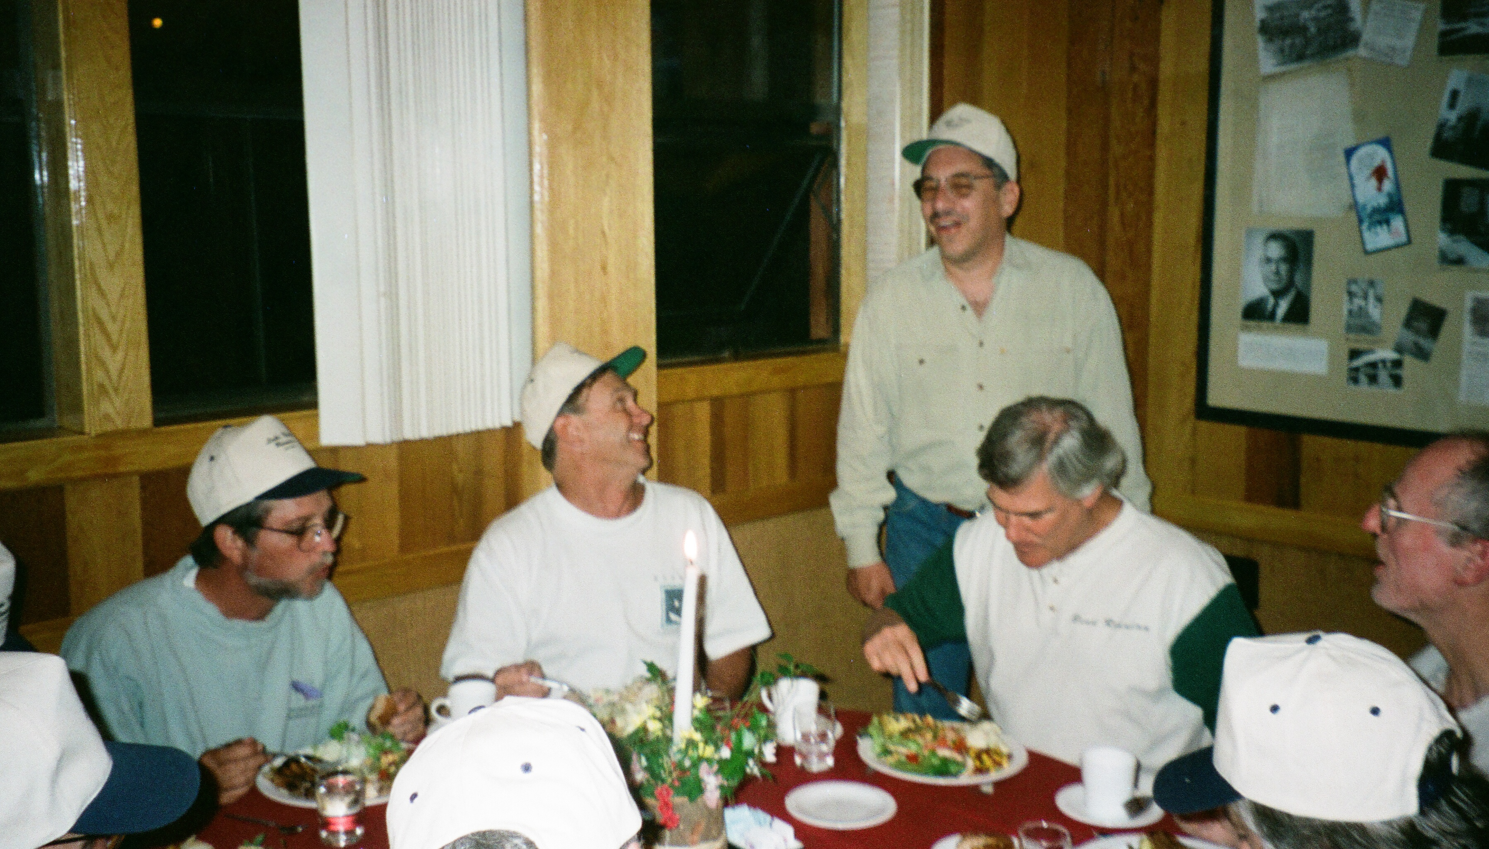

Slide 26
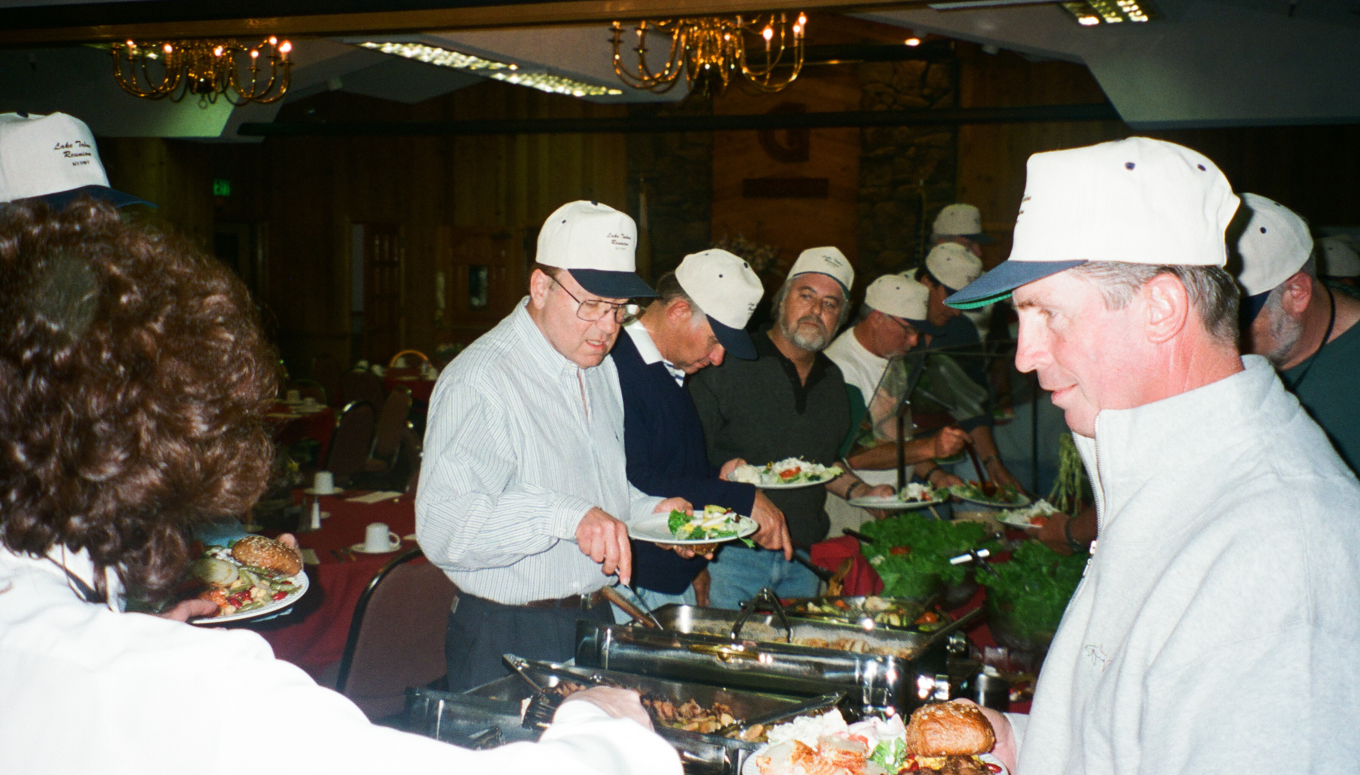

Slide 27
