Slide 1
Math 139 – The Graph of a Rational Function
3 examples
General Steps to Graph a Rational Function
1) Factor the numerator and the denominator
2) State the domain and the location of any holes in the graph
3) Simplify the function by factoring if possible.
4) Find the y-intercept (x = 0) and the x-intercept(s) (y = 0)
5) Identify any existing asymptotes (vertical, horizontal, or oblique/slant)

Slide 2
General Steps to Graph a Rational Function contd.
6) Identify any points intersecting a horizontal or oblique asymptote.
7) Use test points between the zeros and vertical asymptotes to locate the graph above or below the x-axis
8) Analyze the behavior of the graph on each side of an asymptote
9) Sketch the graph

Slide 3



Example #1
$$f\left(x\right)=\frac{x^{2}+x−12}{x^{2}−4}$$
1) Factor the numerator and the denominator
$$f\left(x\right)=\frac{(x+4)(x−3)}{(x+2)(x−2)}$$
2) State the domain and the location of any holes in the graph
Domain: $(−∞,−2)∪(−2, 2)∪(2, ∞)$
No holes (They occur where factors cancel)
3) Simplify the function to lowest terms
$$f\left(x\right)=\frac{(x+4)(x−3)}{(x+2)(x−2)}$$

Slide 4

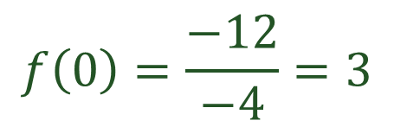

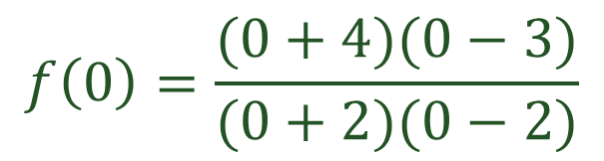





4) Find the y-intercept (x = 0) and the x-intercept(s) (y = 0)
y-intercept (x = 0)
x-intercept(s) (y = 0)
These are the roots of the numerator.
$$f\left(0\right)=\frac{(0+4)(0−3)}{(0+2)(0−2)}$$
$$x+4=0$$
$$x−3=0$$
$$f\left(0\right)=\frac{−12}{−4}=3$$
$$x=−4$$
$$x=3$$
$$(−4, 0)$$
$$(3, 0)$$
$$(0, 3)$$

Slide 5



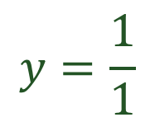




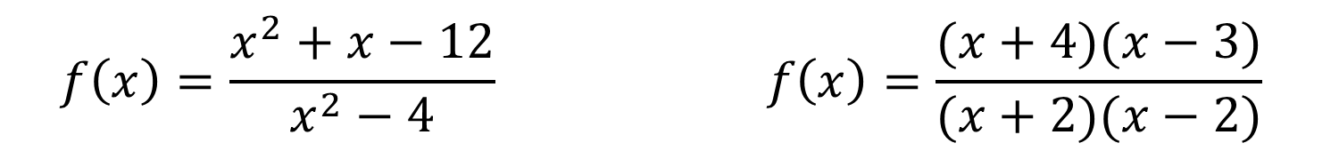
5) Identify any existing asymptotes (vertical, horizontal, or oblique
$$f\left(x\right)=\frac{x^{2}+x−12}{x^{2}−4} f\left(x\right)=\frac{(x+4)(x−3)}{(x+2)(x−2)}$$
Horiz. Or Oblique Asymptotes
Vertical Asymptotes
Examine the largest exponents
Use denominator factors
Same $∴$ Horiz. - use coefficients
$$x+2=0$$
$$x−2=0$$
$$y=\frac{1}{1}$$
$$x=−2$$
$$x=2$$
$$HA: y=1$$
$$VA:x=−2 and x=2$$
Oblique Asymptotes occur when degree is 1 greater on top. Divide using base-x and get rid of denominator to find line.

Slide 6


6) Identify any points intersecting a horizontal or oblique asymptote. (this is possible because unlike a vertical asymptote, the function is defined at these types)
$$y=1 and f\left(x\right)=\frac{x^{2}+x−12}{x^{2}−4}$$
$$1=\frac{x^{2}+x−12}{x^{2}−4}$$
$$x^{2}−4=x^{2}+x−12$$
$$−4=x−12$$
$$8=x$$
$$(8,1)$$

Slide 7

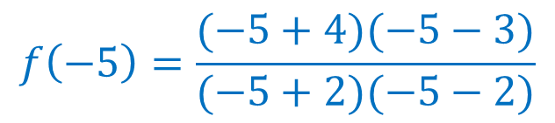

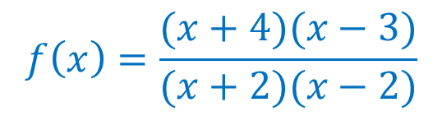
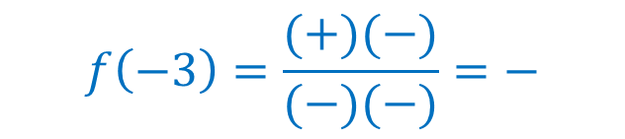



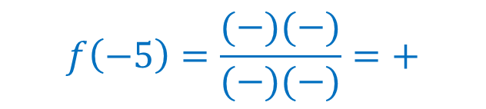

7) Use test points between the zeros and vertical asymptotes to locate the graph above or below the x-axis
$$above$$
$$below$$
$$above$$
-4
-2
2
3
$$f\left(x\right)=\frac{(x+4)(x−3)}{(x+2)(x−2)}$$
$$f\left(−3\right)=\frac{(+)(−)}{(−)(−)}=−$$
$$f\left(−5\right)=\frac{(−5+4)(−5−3)}{(−5+2)(−5−2)}$$
$$f\left(−3\right)=below$$
$$f\left(−5\right)=\frac{(−)(−)}{(−)(−)}=+$$
$$f\left(0\right)=\frac{(+)(−)}{(+)(−)}=+$$
$$f\left(−5\right)=above$$
$$f\left(0\right)=above$$

Slide 8
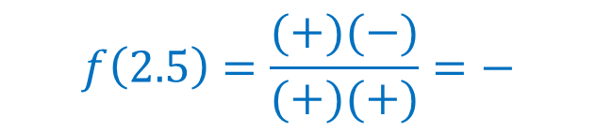





7) Use test points between the zeros and vertical asymptotes to locate the graph above or below the x-axis
$$above$$
$$below$$
$$above$$
$$below$$
$$above$$
-4
-2
2
3
$$f\left(x\right)=\frac{(x+4)(x−3)}{(x+2)(x−2)}$$
$$f\left(2.5\right)=\frac{(+)(−)}{(+)(+)}=−$$
$$f\left(4\right)=\frac{(+)(+)}{(+)(+)}=+$$
$$f\left(2.5\right)=below$$
$$f\left(4\right)=above$$

Slide 9
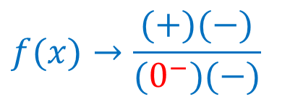



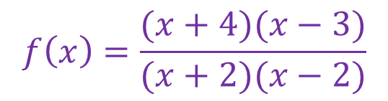

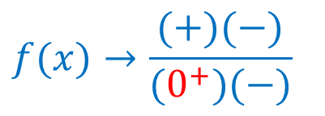




8) Analyze the behavior of the graph on each side of an asymptote
$$above$$
$$below$$
$$above$$
$$below$$
$$above$$
-4
-2
2
3
$$f\left(x\right)=\frac{(x+4)(x−3)}{(x+2)(x−2)}$$
$$f(x)→\frac{(+)(−)}{(0^{−})(−)}$$
$$x→{−2}^{−}$$
$$f(x)→−∞$$
$$f(x)→\frac{(+)(−)}{(0^{+})(−)}$$
$$x→{−2}^{+}$$
$$f(x)→∞$$

Slide 10


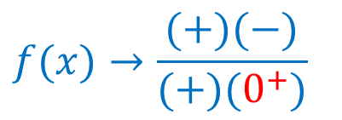


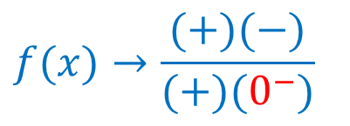
8) Analyze the behavior of the graph on each side of an asymptote
$$above$$
$$below$$
$$above$$
$$below$$
$$above$$
-4
-2
2
3
$$f\left(x\right)=\frac{(x+4)(x−3)}{(x+2)(x−2)}$$
$$f(x)→\frac{(+)(−)}{(+)(0^{−})}$$
$$x→2^{−}$$
$$f(x)→∞$$
$$f(x)→\frac{(+)(−)}{(+)(0^{+})}$$
$$x→2^{+}$$
$$f\left(x\right)→−∞$$

Slide 11

9) Sketch the graph

Slide 12



Example #2
$$f\left(x\right)=\frac{x^{2}+3x−10}{x^{2}+8x+15}$$
1) Factor the numerator and the denominator
$$f\left(x\right)=\frac{(x+5)(x−2)}{(x+5)(x+3)}$$
2) State the domain and the location of any holes in the graph
Domain: $(−∞,−5)∪(−5, −3)∪(−3, ∞)$
Hole in the graph at $x=−5$
3) Simplify the function to lowest terms
$$f\left(x\right)=\frac{(x−2)}{(x+3)}$$

Slide 13
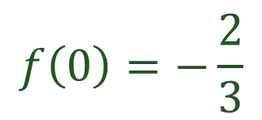

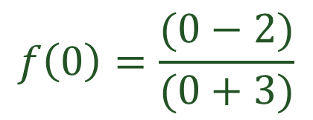


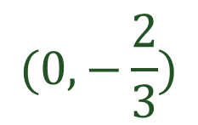
4) Find the y-intercept (x = 0) and the x-intercept(s) (y = 0)
y-intercept (x = 0)
x-intercept(s) (y = 0)
$$f\left(0\right)=\frac{(0−2)}{(0+3)}$$
Use numerator factors
$$x−2=0$$
$$f\left(0\right)=−\frac{2}{3}$$
$$x=2$$
$$(2, 0)$$
$$(0,−\frac{2}{3})$$

Slide 14


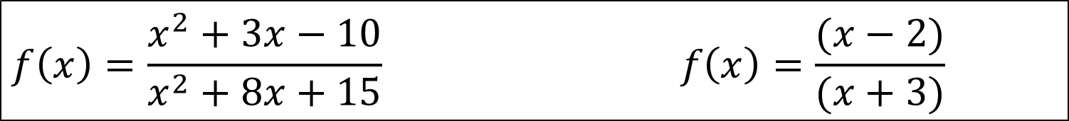
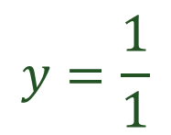



5) Identify any existing asymptotes (vertical, horizontal, or oblique
$$f\left(x\right)=\frac{x^{2}+3x−10}{x^{2}+8x+15} f\left(x\right)=\frac{(x−2)}{(x+3)}$$
Horiz. Or Oblique Asymptotes
Vertical Asymptotes
Examine the largest exponents
Use denominator factors
Same $∴$ Horiz. - use coefficients
$$x+3=0$$
$$y=\frac{1}{1}$$
$$x=−3$$
$$VA:x=−3$$
$$HA: y=1$$

Slide 15
6) Identify any points intersecting a horizontal or oblique asymptote.
$$y=1 and f\left(x\right)=\frac{x−2}{x+3}$$
$$1=\frac{x−2}{x+3}$$
$$x+3=x−2$$
$$3=−2$$
$$lost variable$$
$$no points of intersection on the asymptote$$

Slide 16




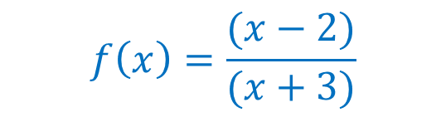




7) Use test points between the zeros and vertical asymptotes to locate the graph above or below the x-axis
$$above$$
$$below$$
$$above$$
-3
2
$$f\left(x\right)=\frac{(x−2)}{(x+3)}$$
$$f\left(0\right)=\frac{(−)}{(+)}=−$$
$$f\left(−4\right)=\frac{(−4−2)}{(−4+3)}$$
$$f\left(0\right)=below$$
$$f\left(−4\right)=\frac{(−)}{(−)}=+$$
$$f\left(3\right)=\frac{(+)}{(+)}=+$$
$$f\left(−4\right)=above$$
$$f\left(3\right)=above$$

Slide 17

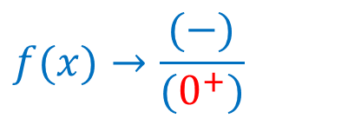
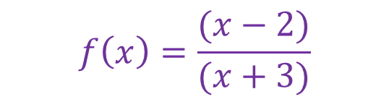

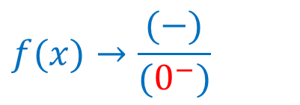
8) Analyze the behavior of the graph on each side of an asymptote
-3
2
$$f\left(x\right)=\frac{(x−2)}{(x+3)}$$
$$f(x)→\frac{(−)}{(0^{−})}$$
$$x→{−3}^{−}$$
$$f(x)→∞$$
$$f(x)→\frac{(−)}{(0^{+})}$$
$$x→{−3}^{+}$$
$$f\left(x\right)→−∞$$

Slide 18
9) Sketch the graph

Slide 19


Example #3
$$f\left(x\right)=\frac{x^{2}+3x+2}{x−1}$$
1) Factor the numerator and the denominator
$$f\left(x\right)=\frac{(x+2)(x+1)}{x−1}$$
2) State the domain and the location of any holes in the graph
Domain: $(−∞,1)∪(1, ∞)$
No holes
3) Simplify the function to lowest terms
$$f\left(x\right)=\frac{(x+2)(x+1)}{(x−1)}$$

Slide 20

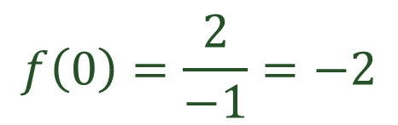

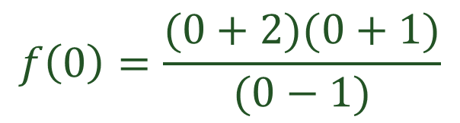





4) Find the y-intercept (x = 0) and the x-intercept(s) (y = 0)
y-intercept (x = 0)
x-intercept(s) (y = 0)
$$f\left(0\right)=\frac{(0+2)(0+1)}{(0−1)}$$
Use numerator factors
$$x+2=0$$
$$x+1=0$$
$$f\left(0\right)=\frac{2}{−1}=−2$$
$$x=−2$$
$$x=−1$$
$$(−2, 0)$$
$$(−1, 0)$$
$$(0,−2)$$

Slide 21
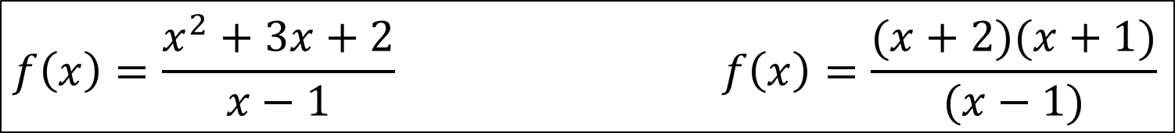














5) Identify any existing asymptotes (vertical, horizontal, or oblique
$$f\left(x\right)=\frac{x^{2}+3x+2}{x−1} f\left(x\right)=\frac{(x+2)(x+1)}{(x−1)}$$
Horiz. or Oblique Asymptotes
Vertical Asymptotes
Examine the largest exponents
Use denominator factors
Oblique: Use long division
$$x−1=0$$
$$x$$
$$+4$$
$$x=1$$
$$x−1$$
$$− +$$
$$x^{2}− x$$
$$VA:x=1$$
$$4x$$
$$+2$$
$$4x−4$$
$$OA: y=x+4$$
$$− +$$
$$0$$

Slide 22


6) Identify any points intersecting a horizontal or oblique asymptote.
$$y=x+4 and f\left(x\right)=\frac{(x+2)(x+1)}{x−1}$$
$$x+4=\frac{(x+2)(x+1)}{x−1}$$
$$(x+4)(x−1)=(x+2)(x+1)$$
$$x^{2}+3x−4=x^{2}+3x+2$$
$$lost variable$$
$$no points of intersection on the asymptote$$

Slide 23
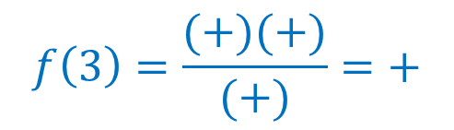

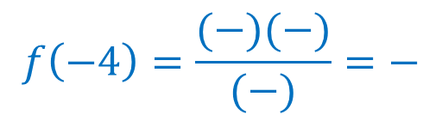


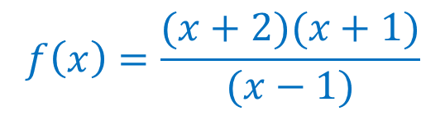
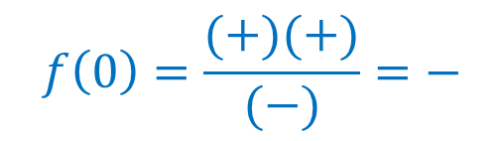

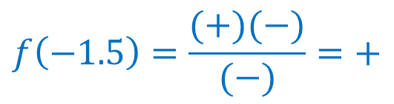

7) Use test points between the zeros and vertical asymptotes to locate the graph above or below the x-axis
$$below$$
$$above$$
$$below$$
$$above$$
-2
-1
1
$$f\left(x\right)=\frac{(x+2)(x+1)}{(x−1)}$$
$$f\left(−1.5\right)=\frac{(+)(−)}{(−)}=+$$
$$f\left(−4\right)=\frac{(−)(−)}{(−)}=−$$
$$f\left(3\right)=\frac{(+)(+)}{(+)}=+$$
$$f\left(−1.5\right)=above$$
$$f\left(0\right)=\frac{(+)(+)}{(−)}=−$$
$$f\left(−4\right)=below$$
$$f\left(3\right)=above$$
$$f\left(0\right)=below$$

Slide 24


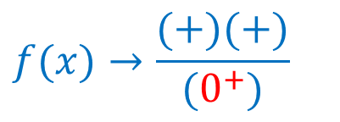
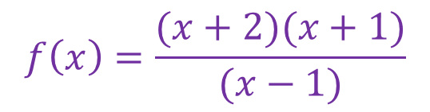


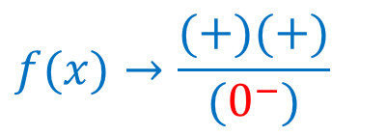
8) Analyze the behavior of the graph on each side of an asymptote
1
$$f\left(x\right)=\frac{(x+2)(x+1)}{(x−1)}$$
$$f(x)→\frac{(+)(+)}{(0^{−})}$$
$$x→1^{−}$$
$$f\left(x\right)→−∞$$
$$f(x)→\frac{(+)(+)}{(0^{+})}$$
$$x→1^{+}$$
$$f\left(x\right)→∞$$

Slide 25
9) Sketch the graph

