Slide 1
There Might be giants? -A Proportional Reasoning Activity for Prospective Teachers
Math 100
Summer 2015
Lance Burger
Fresno State

Slide 5
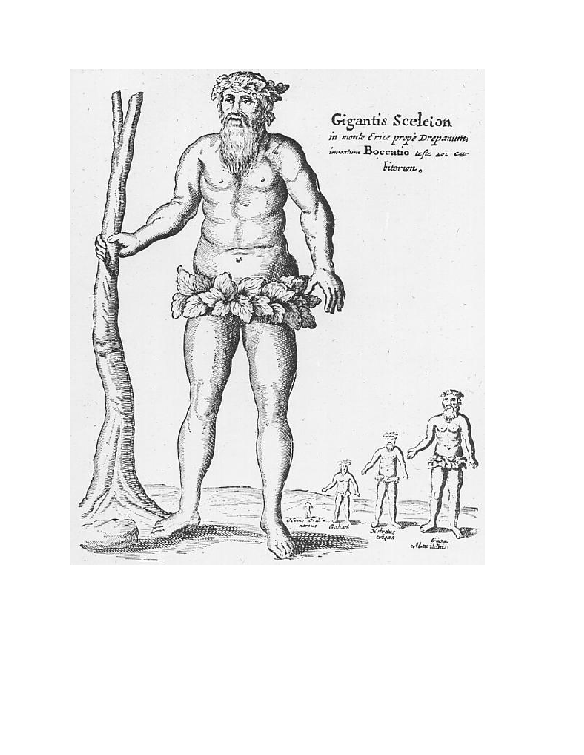

Slide 6
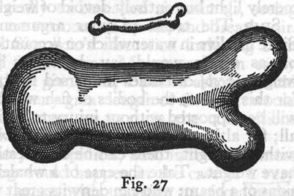
Who does not know that a horse falling from a height of three or four cubits will break his bones, while a dog falling from the same height or a cat from a height of eight or ten cubits will suffer no injury? ... Galileo-Two New Sciences

Slide 7
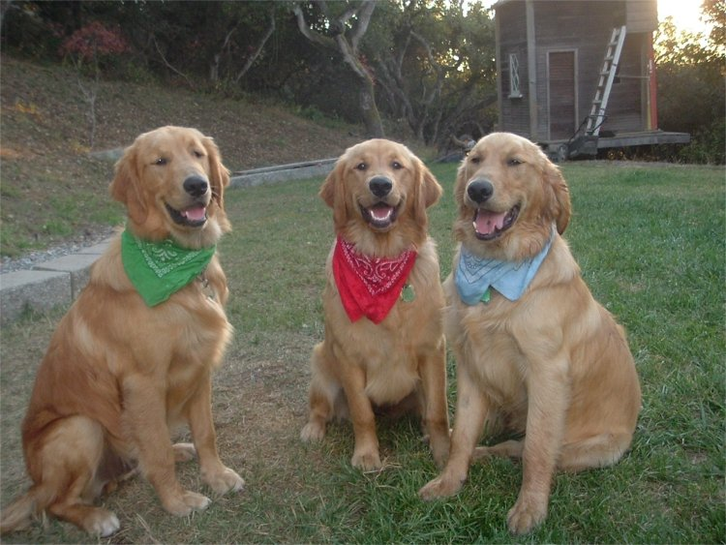

Slide 8
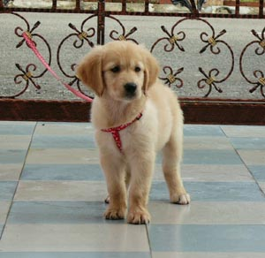
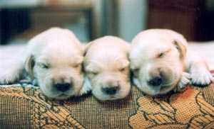

Slide 9
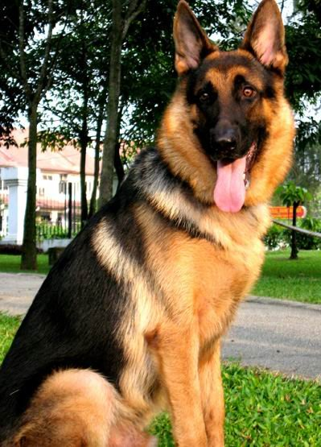

Slide 10
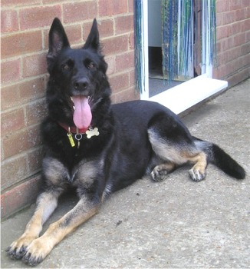
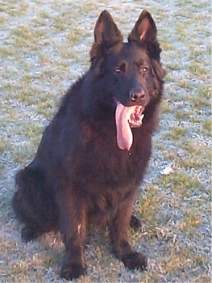

Slide 11
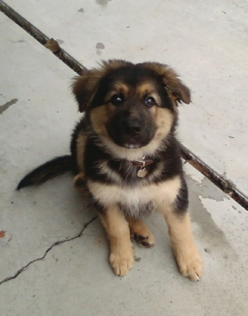
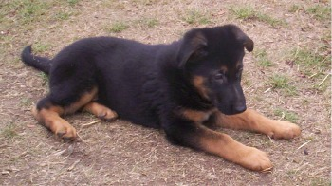
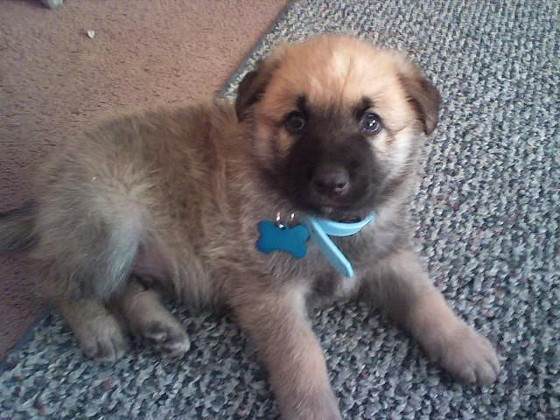

Slide 12
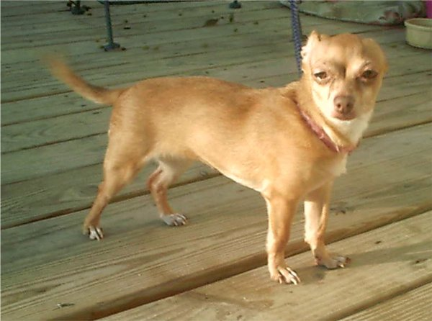
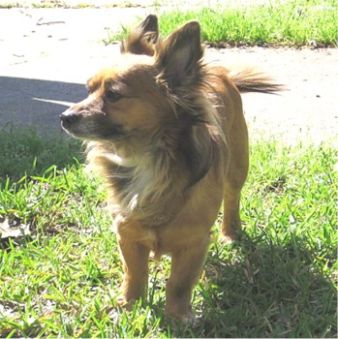

Slide 13
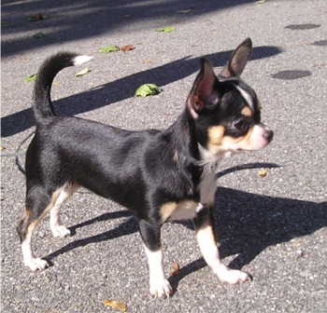
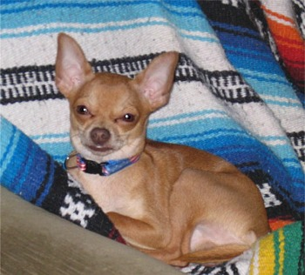
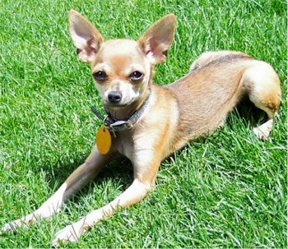

Slide 14
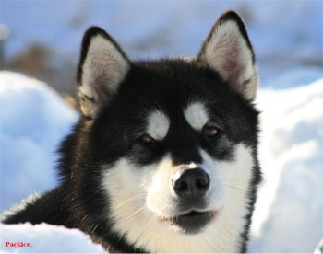
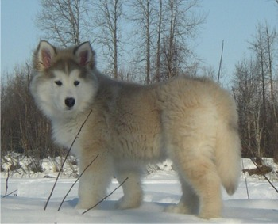
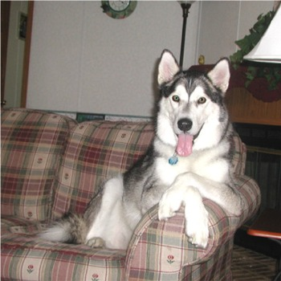

Slide 15
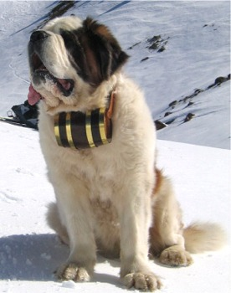
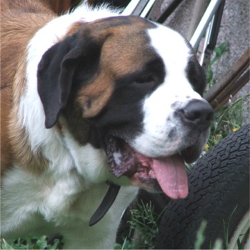
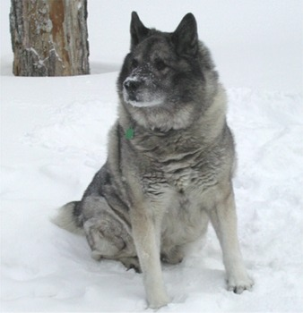

Slide 16
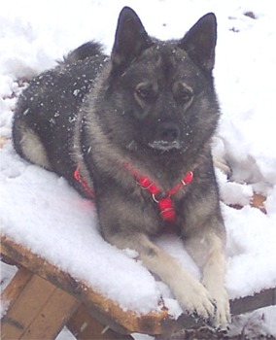
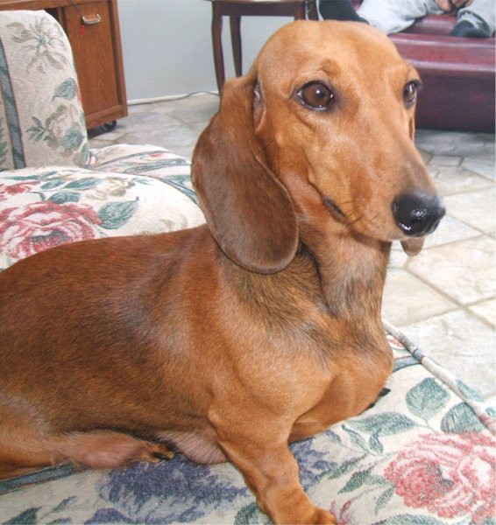
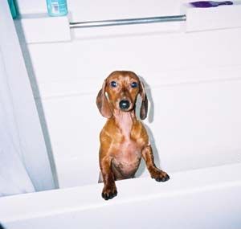

Slide 17
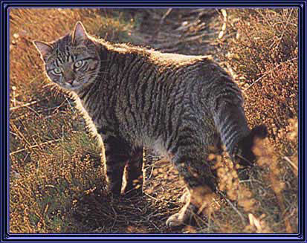
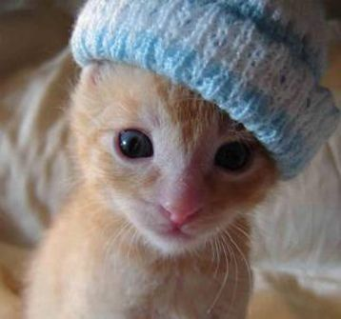
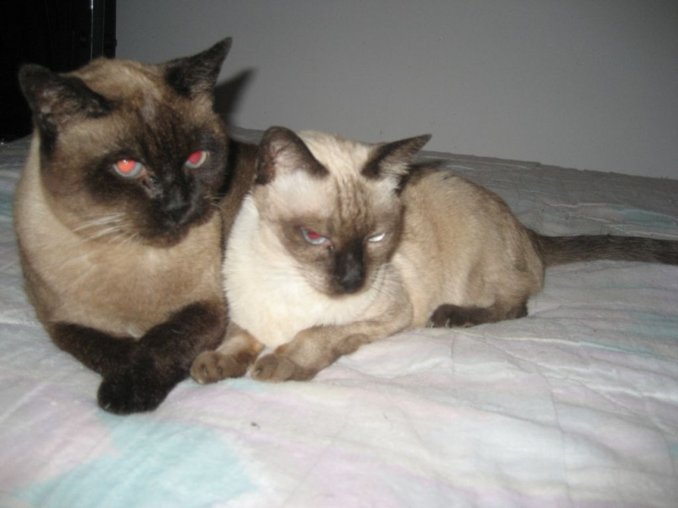

Slide 18
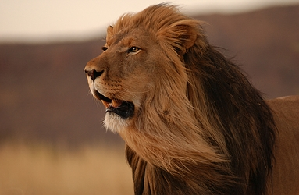
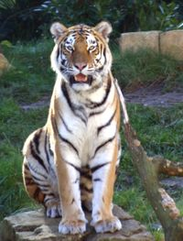
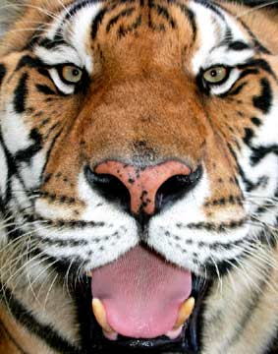

Slide 19
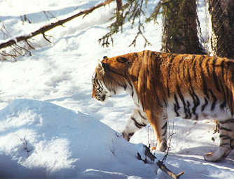
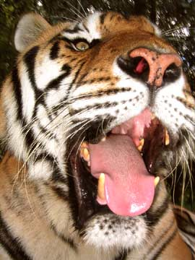
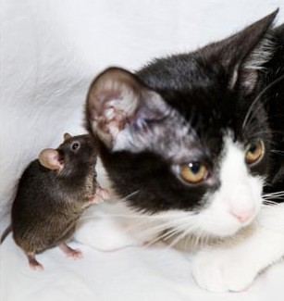
Notes:
Next slide asks QUESTION: WHY DO LARGE DOGS SEEM TO PANT MORE THAN SMALL DOGS?

Slide 20
Q. Why do large dogs seem to pant more than small dogs?

Slide 21
FRONT & BACK
SIDES
TOP & BOTTOM

Slide 22
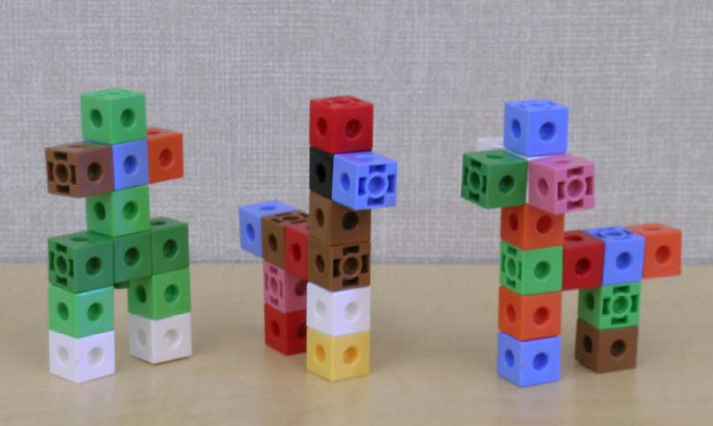

Slide 23
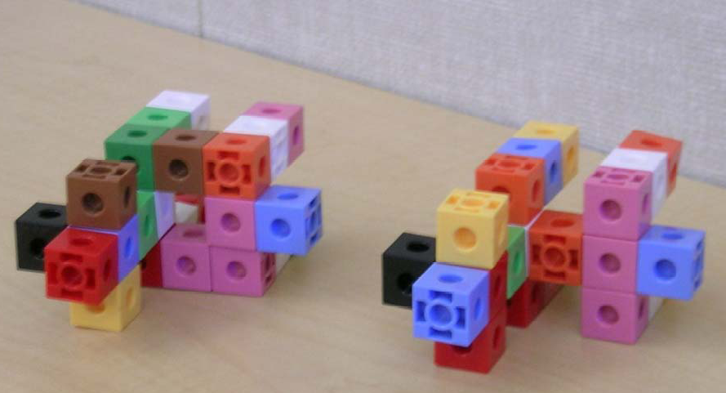

Slide 24
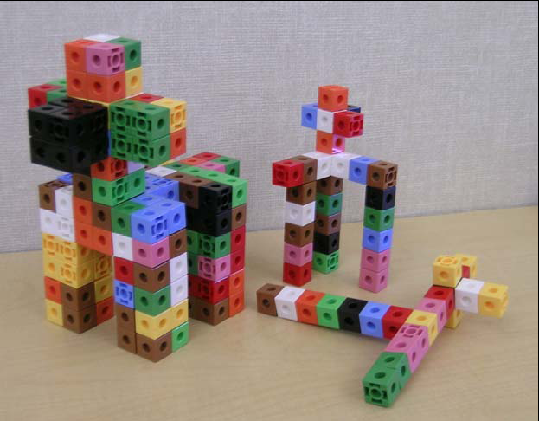

Slide 25
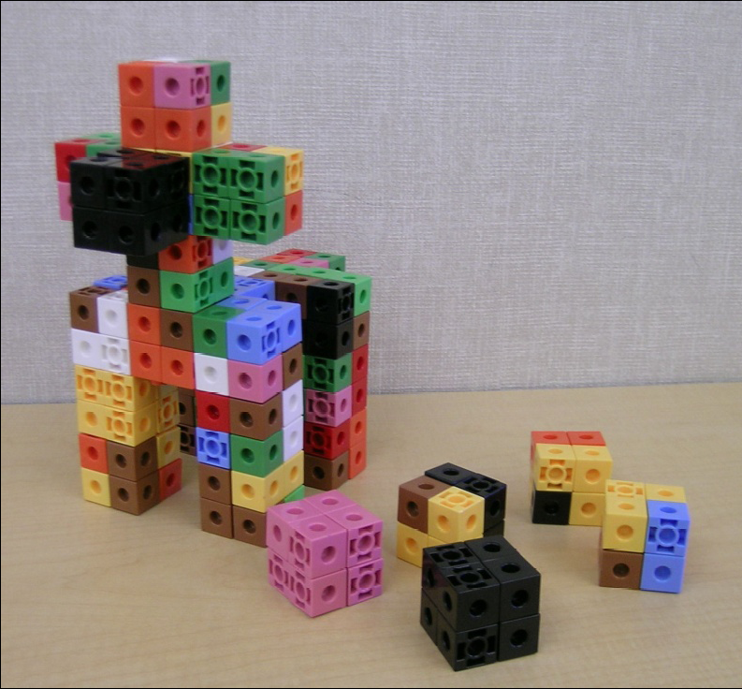

Slide 26
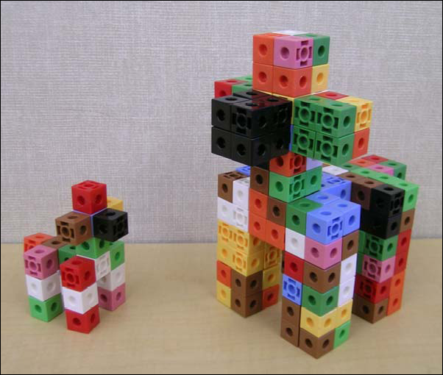

Slide 27
Reasoning from Manipulatives:
Mathematical Concepts Related to LARGE and small dogs.
Mathematical Concepts Related to HEAT EXCHANGE.
How Can These Concepts be Compared Mathematically?

Slide 28
A demonstration about cooling:
Equal volumes of 100C water are placed in containers having different areas of exposure:
After several minutes measure the respective water temperatures with thermometers, significant differences in temperatures are seen.

Slide 29
A second cognitive disequilibrium of lesson:
If more surface area produces better cooling, then why do large dogs appear hotter,…, they have more surface area than a small dog!

Slide 30
Reasoning from Manipulatives continued:
How can we compare surface area and volume AT THE SAME TIME?

Slide 33
As for the 200foot woman:
A 5 foot woman made six times larger twice would reach 180 feet.
(1/6)^2 is 1/36
She would have 1/36 less skin as compared with the 5 foot woman.
No wonder she is in such a small swimsuit … she is burning up!

Slide 34
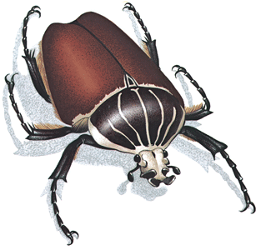
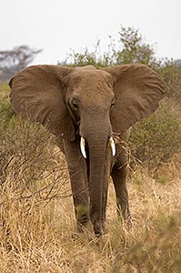
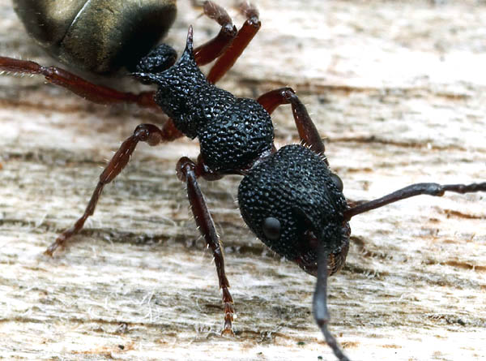

Slide 35
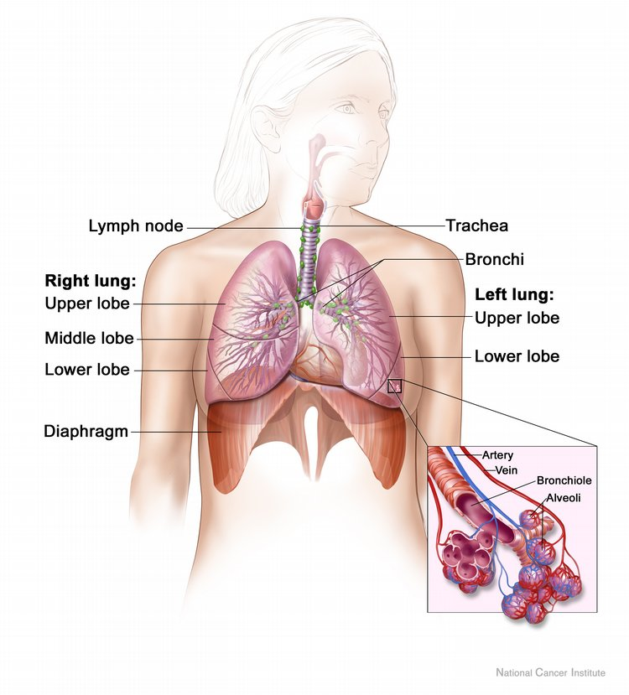
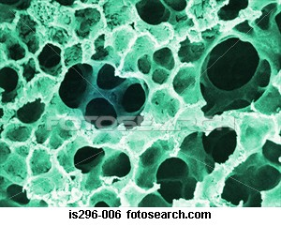

Slide 36
p=8
a=4
P=16
A=16
p/a=2/1
P/A=1/1

Slide 37
c=2(pi)r C=2(pi)2r
a=(pi)r^2
A=(pi)(2r)^2
=4(pi)r^2
c/a =2(pi)r/(pi)r^2=2/r
C/A=2(pi)2r/4(pi)r^2=1/r

